Slide 1

Mobility活用 マネタイズ

Slide 2
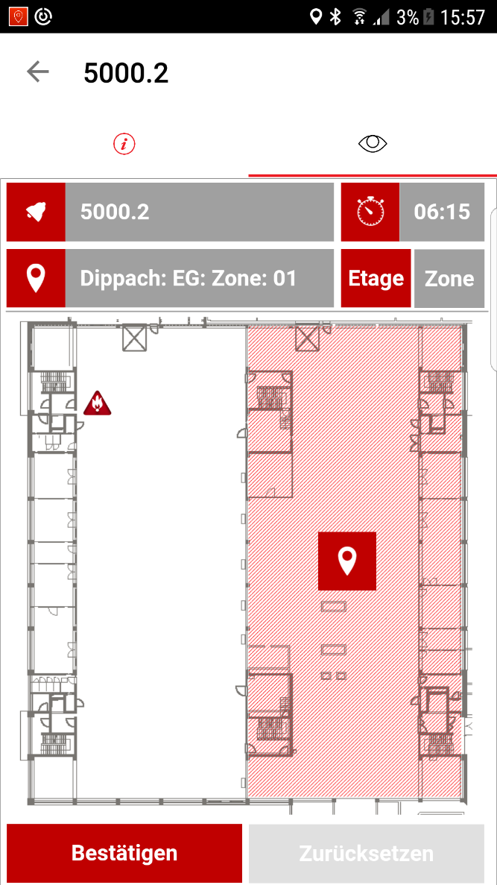
Germany
Contextual projects

Slide 3
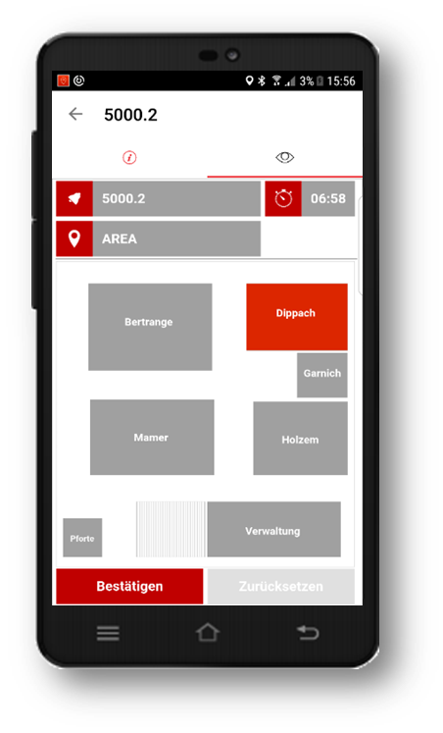
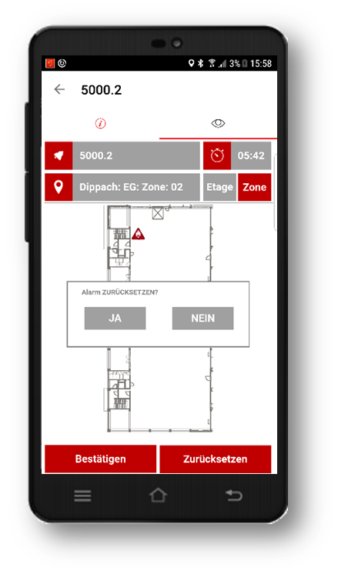
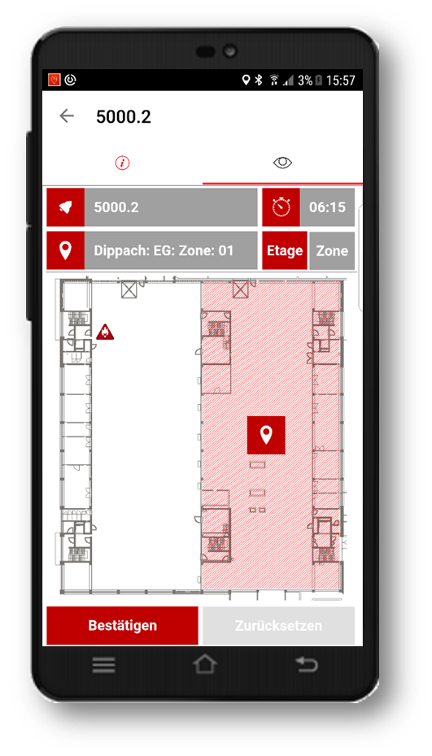
監視操作の利便性向上
Project needs
火報・設備異常の際の現場駆け付けFire Alarming, Route optimization and fire confirmation
2000 Fire and smoke detectors at the Mamer site.
Connected via BOSCH central fire alarm system (OPC)
First Version :
2000 Beacon zones with coverage factor 0.8.
NFC close to every beacon to confirm NOFIRE
2000のビーコンを使用して領域をカバーするが、カバー率は８０％である。

Slide 4
Risks, Expectations, Issues
Project Risks after technical clarification
Cost of maintenance, Workload / Year very high. (2000 Beacons)
Management Decision:
Change to a mix with existing WIFI-Hotspots, Beacons in gray zones, NFC tag close to every beacon also cancelled.
Reduced to 50 additional Beacon zones with 12 WIFI zones
Availability of APPS in Appstores
Business-Device Enrol program IT mandatory.
No BYOD allowed.
ビーコン一つあたりの物理的なコスト、電池交換や管理費もあるので、人件費と物理費でコストが高くなる。
ビーコン：自動でデバイスにデータ送信
NFCタグ：手動でタグを読み取り、データを取得
コストはNFCタグ<ビーコン

Slide 5
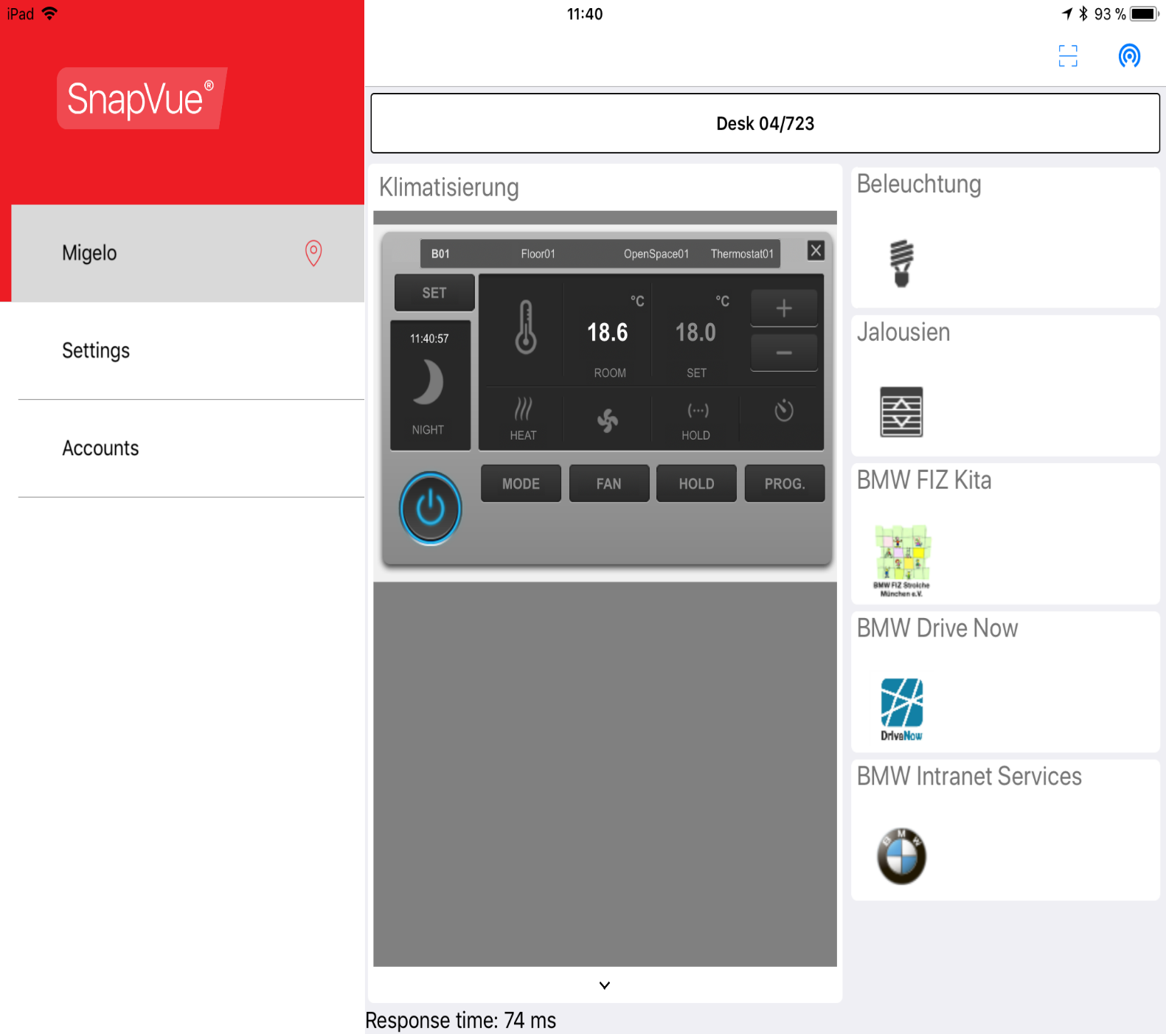
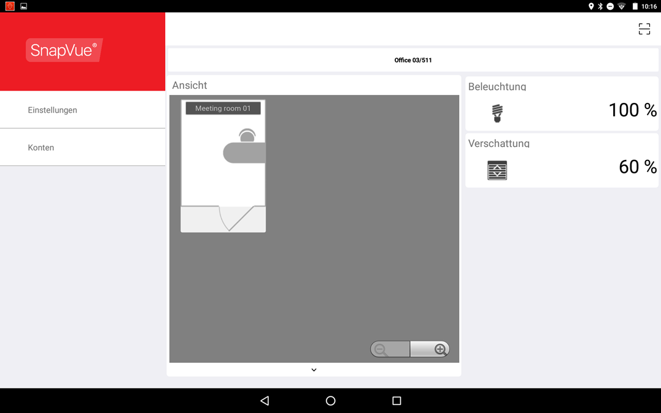
BMW_Lighting Control / WAGO (Start Pilot 2018)
Project needs
Lighting control of an office building with 150.000 sqm.
Offices, corridors, meeting rooms
5000 users via IOS iPhone and Active Directory
Connected via WAGO / DALI BACNET Control system
First Version :
1000 zones with coverage factor 0.8.
NFC close to every desk or individual workspace.

Slide 6
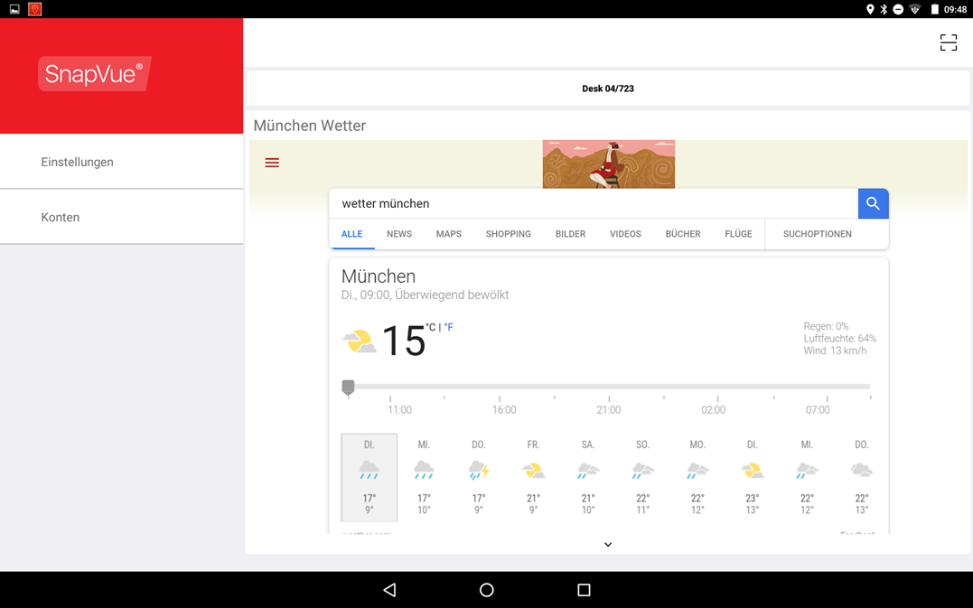
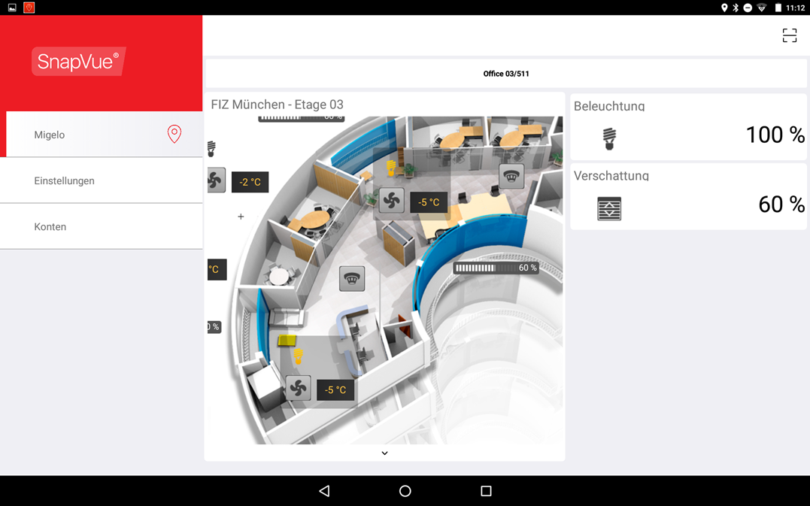
BMW Corporate Services

Slide 7
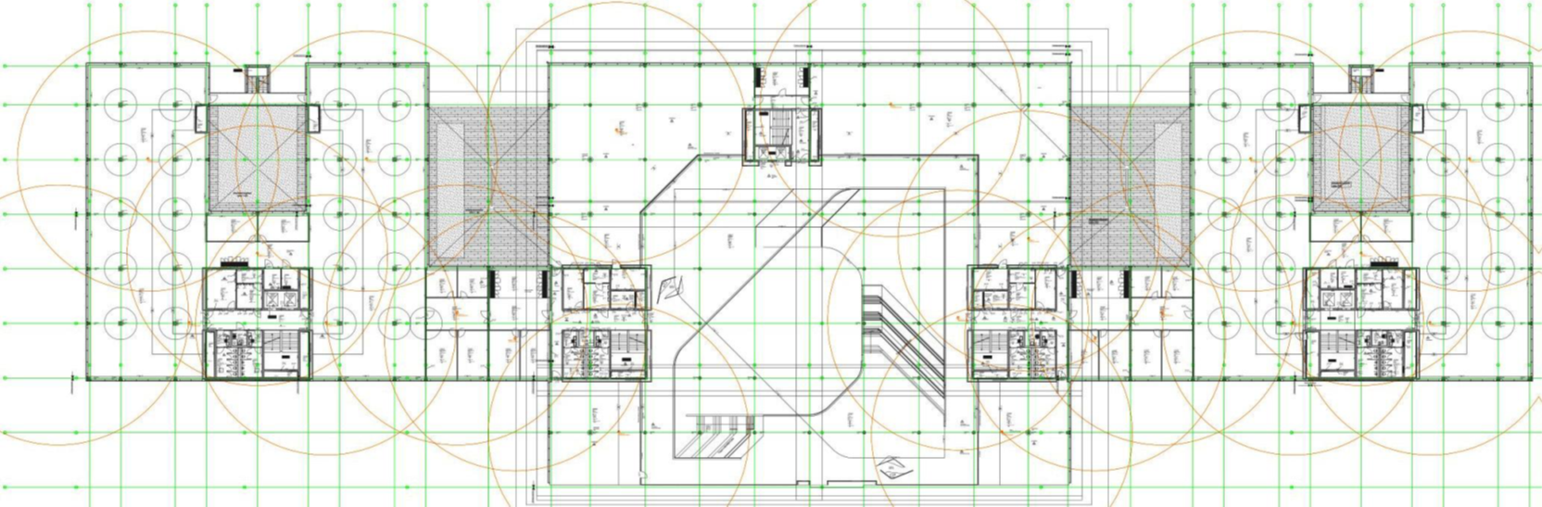
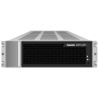

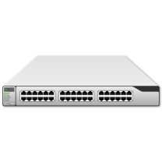

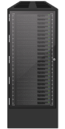


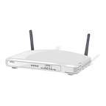
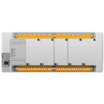
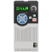



Systemarchitecture / Links
ビーコンの通信範囲の重複領域にいる時、Snapvueにはそれぞれのビーコンから送信された情報が表示される。
ActiveDirectory
Server
LDAP
OPC UA
Zenon
BMS System
ContextVue
Server
BACnet/IP
HTTPS/REST
Fieldlevel WAGO:
Controller (DDC) & Sensors
SnapVue
Smart Mobile Devices
Notes:
ContextVue Server muss nicht zwangsläufig nur ein einziger Computer sein…
Kann auch hochskaliert werden…
Insbesondere ist es sinnvoll den WebServer-Layer vom eigentlichen ContextVue-Server zu trennen…

Slide 8
Risks, Expectations, Issues
Project Risks after technical clarification
1000 concurrent users
Implementation of SnapVue App in existing BMW Staff member Service APP
Management Decision: Need for SDK
Availability of APPS in Appstores
Business-Device Enrol program from IT is mandatory.
All bigger customers are using such programs for there mobiles, no BYOD allowed.

Slide 9
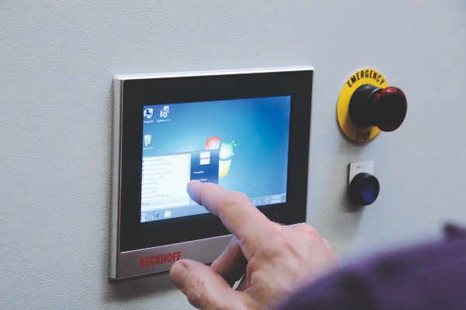
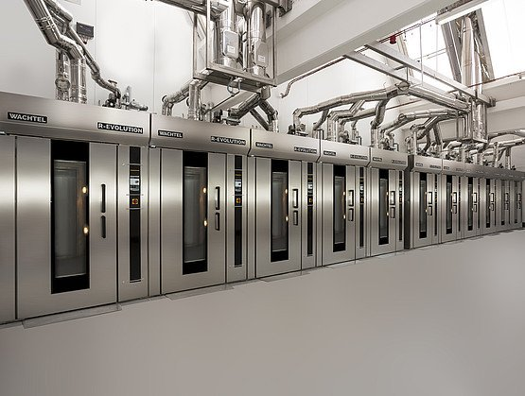
Albrecht HMI replacement ( Started with BETA)
Project needs
Replacement of 100 Beckhoff HMI Panels in cabinets for industrial bakery
Connected via Beckhoff PLC / Cabinet
First Version :
WIFI Accesspoint, one Beacon, one NFC /Cabinet

Slide 10
Risks, Expectations, Issues
Project Risks after technical clarification
WIFI coverage
Testing on site and adaptation of cover
Duplicating Beckhoff HMI to WebVue mimics
Additional workload
Protection against industrial espionage. Recipes, clues of production
No OT knowledges in IT
PcVue Secure appliance with Kaspersky/Advantech bundle.

Slide 11
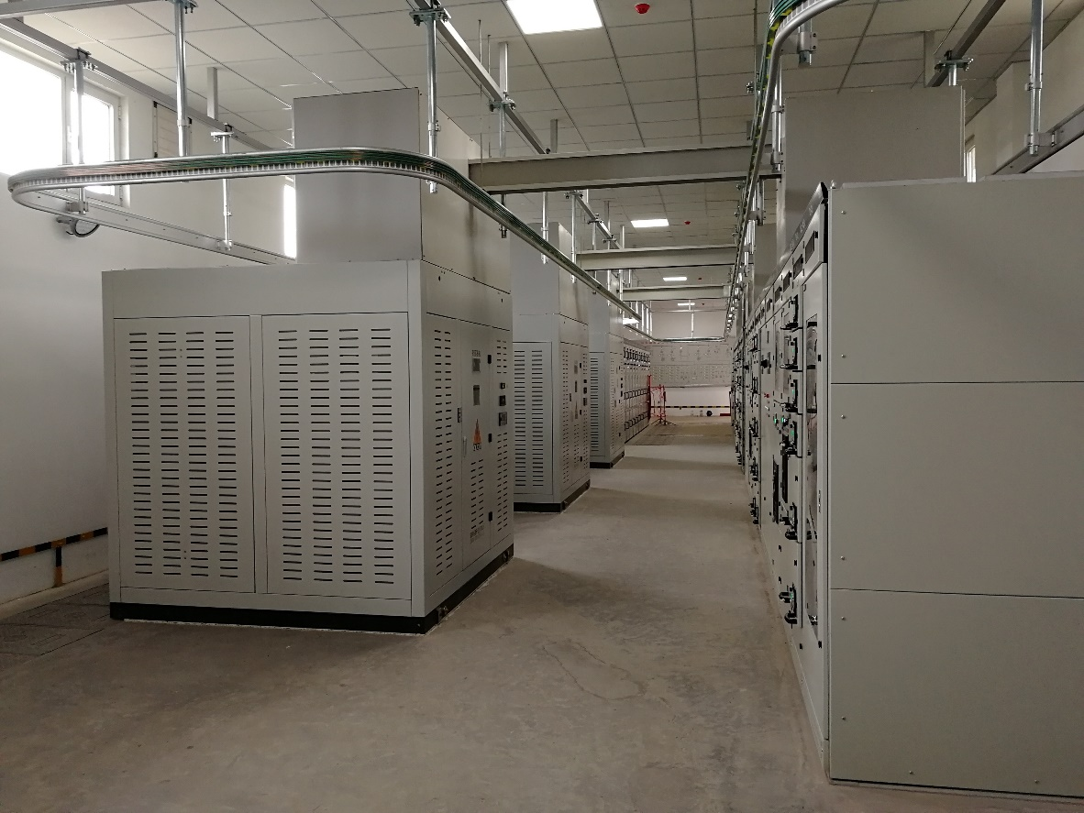
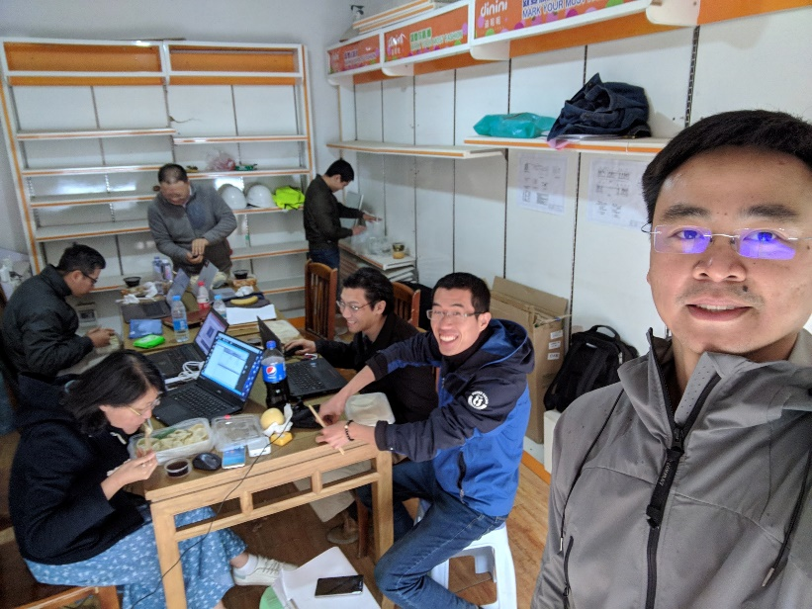
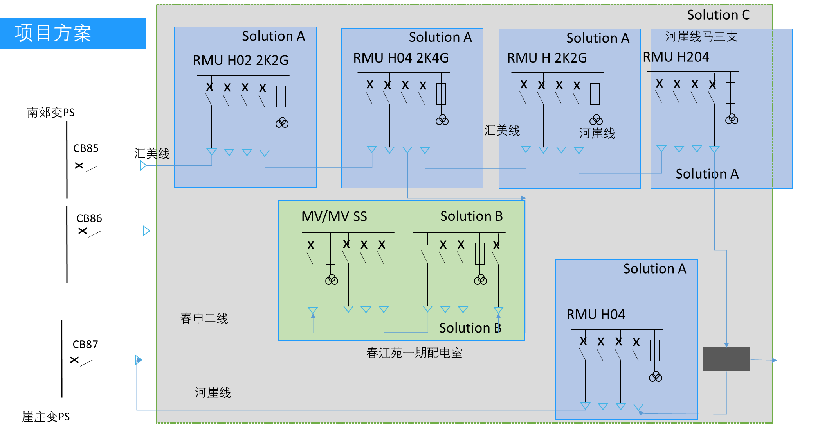
Context
Project POC for ZIBO City, part of Digitalization of Power Grid 13th 5-year plan of Shandong province
Asset Management (predictive maintenance and health score card) and Mobility as selling points
Target April 2018
1 MVMV substation
5 RMU
Same usage as SMARTPIX project for SE in 2016
Locamation is the SI, and PcVue took part in Mobility deployment

Slide 12
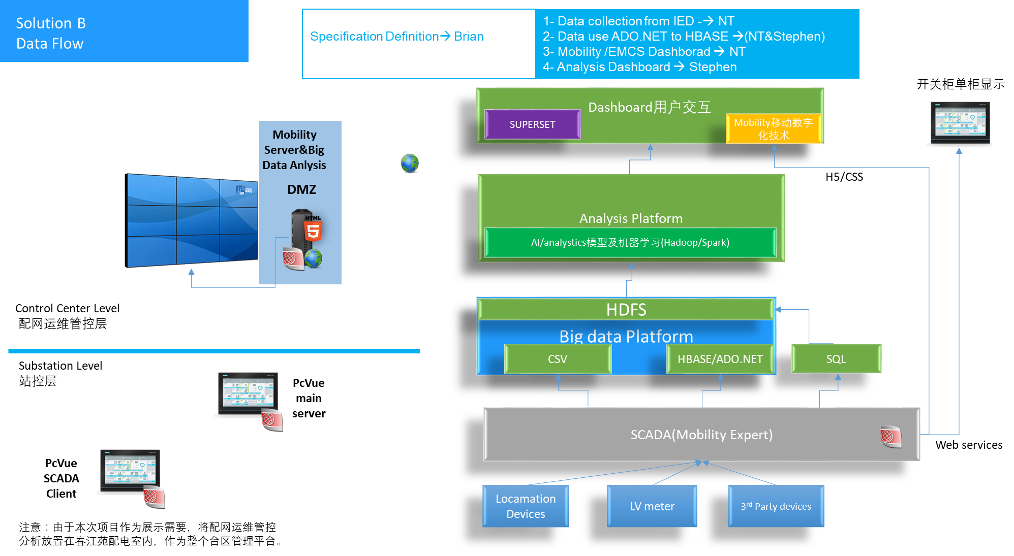
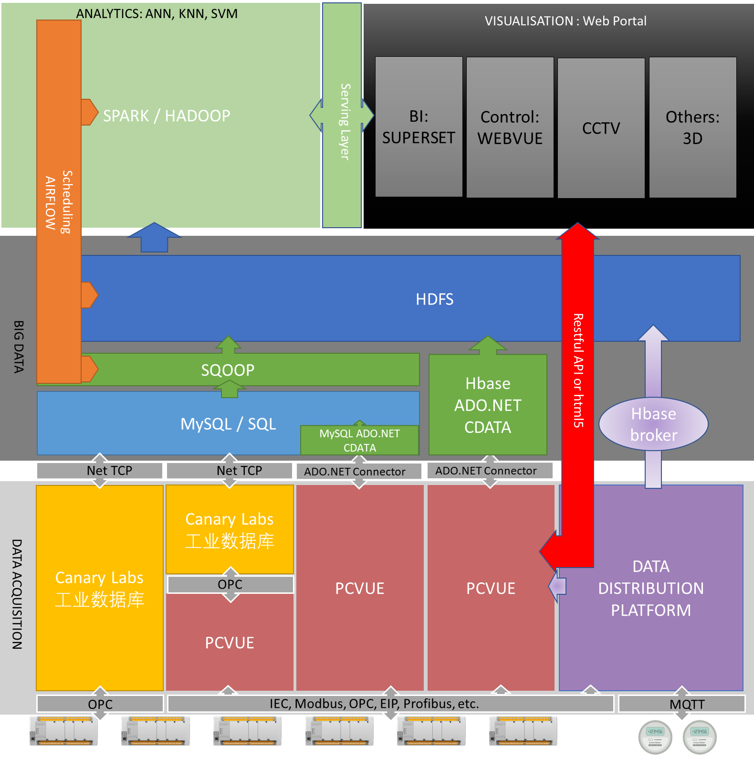
Diagram Architecture
PcVue as Data Acquisition, monitoring and Control and server
Data retrieved from
Locamation Device using 104
NARI protection relay using 61850
LV from Kingview gateway in Modbus IP
Environment meters in Modbus IP
Data sent using IEC 104, webservices
SQL server in dedicated Analytics Server
Analytics (Spark, KNN) with model using PcVue data
Visualization only on Web
Control UI based on WebVue NT
Mobile client for advanced maintenance and operation
Analytics using Superset
Notes:
data type: MV (power measurement, temperature, PD), LV (measures, conditions), environment

Slide 13
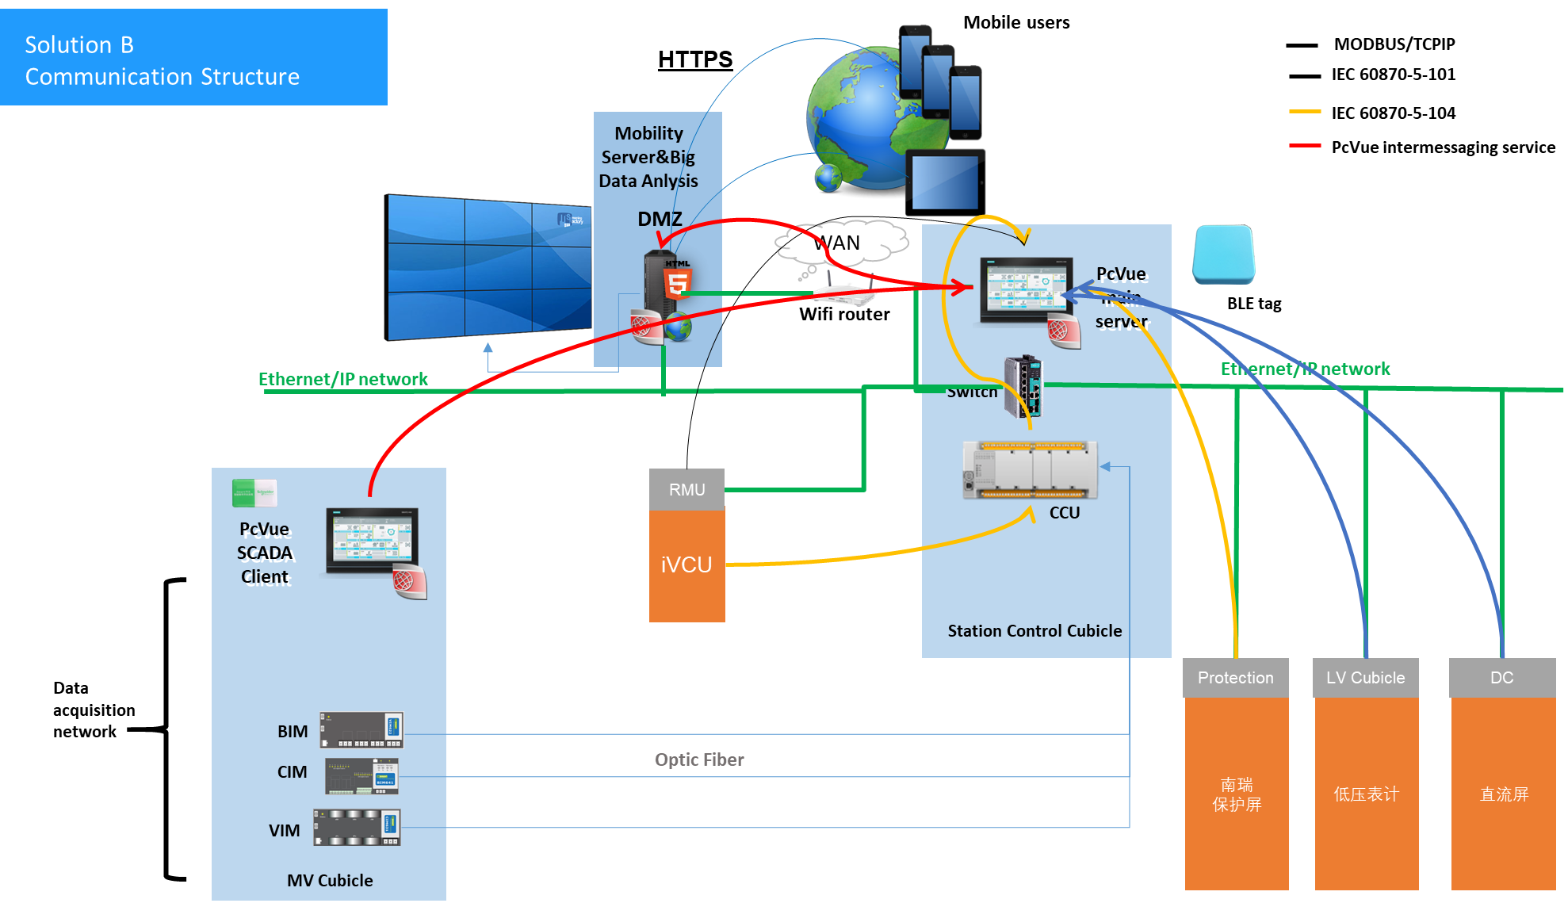
Licensing Architecture
One PcVue SCADA server in an embedded IPC in the main cubicle of the MVMV station
Client station in 7 cubicle
Mobility server in separate PC, in charge of WebVue server and ContextVue
1 BLE in MVMV station + 1 NFC tags per bay （~30）
~4000 IO for MVMV

Slide 14
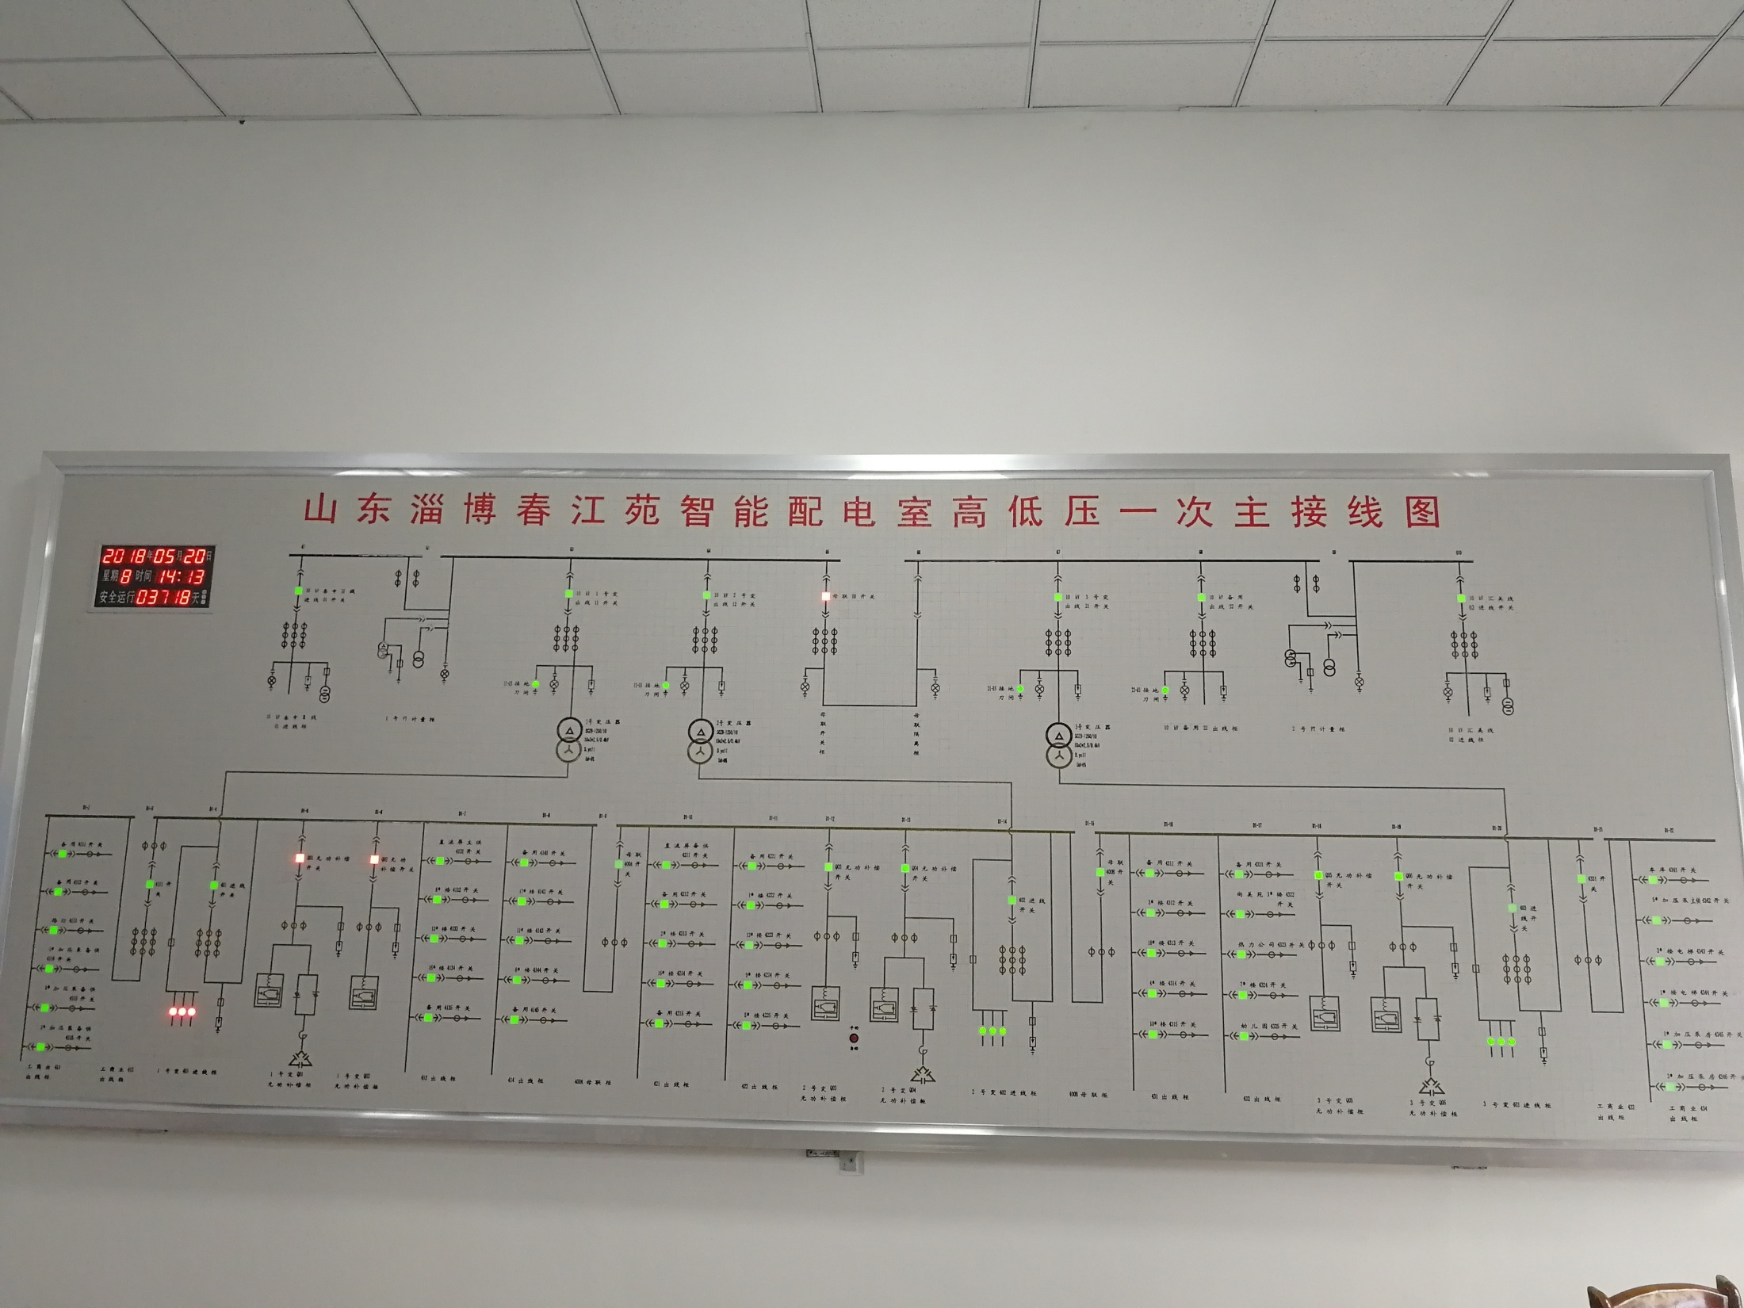
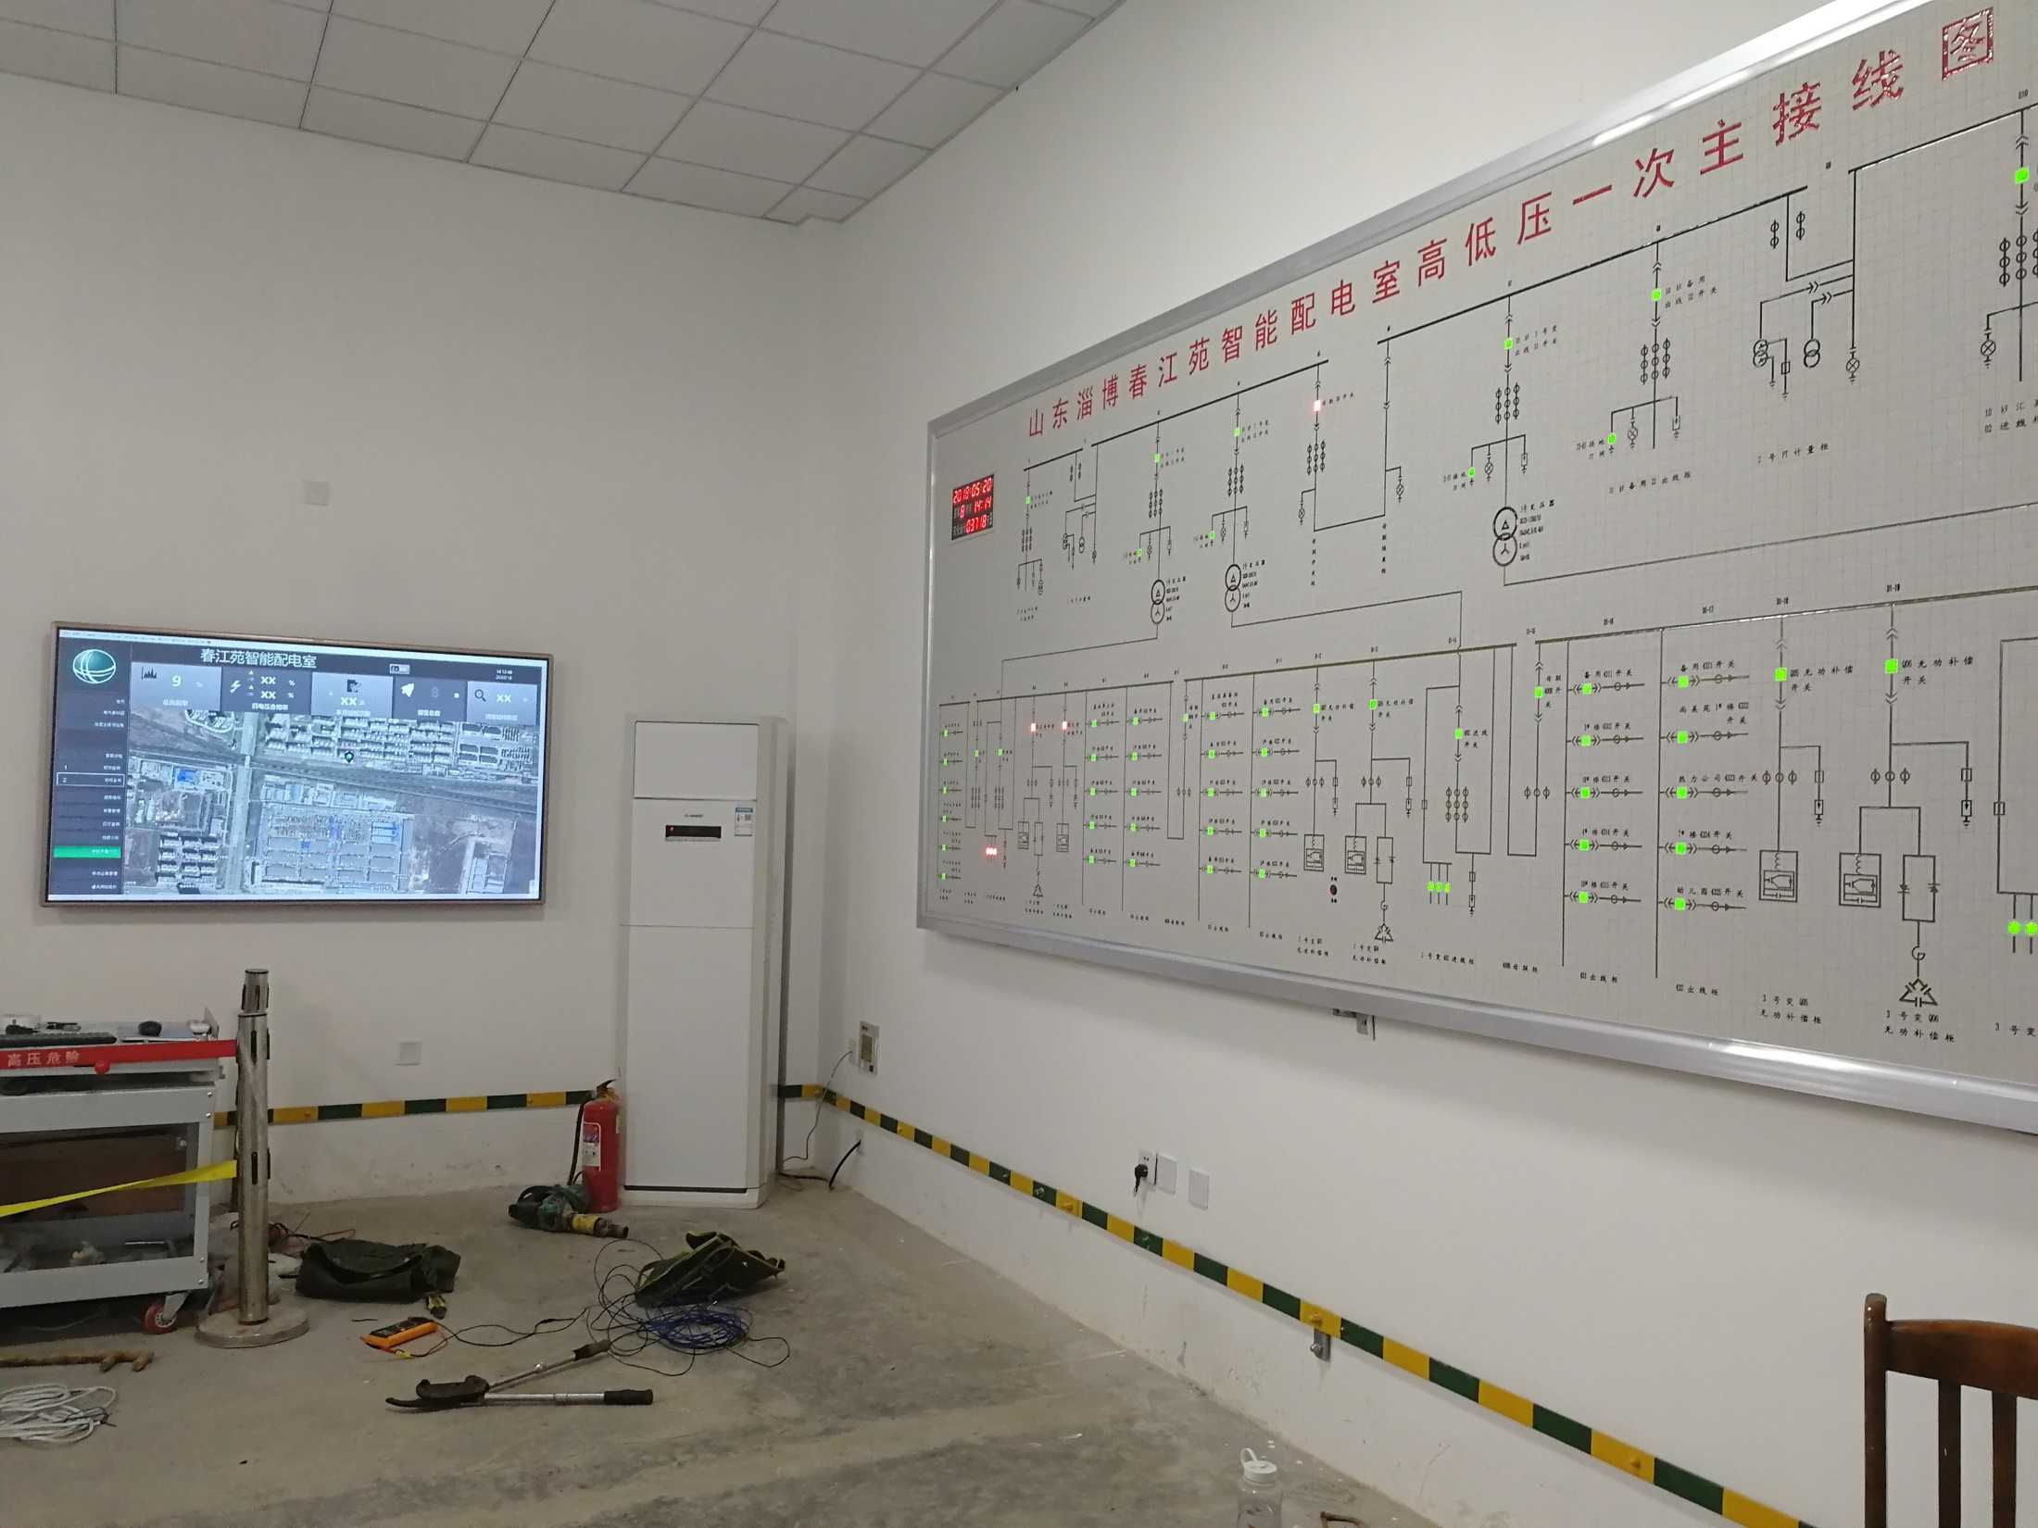
IEC 104 server

Slide 15
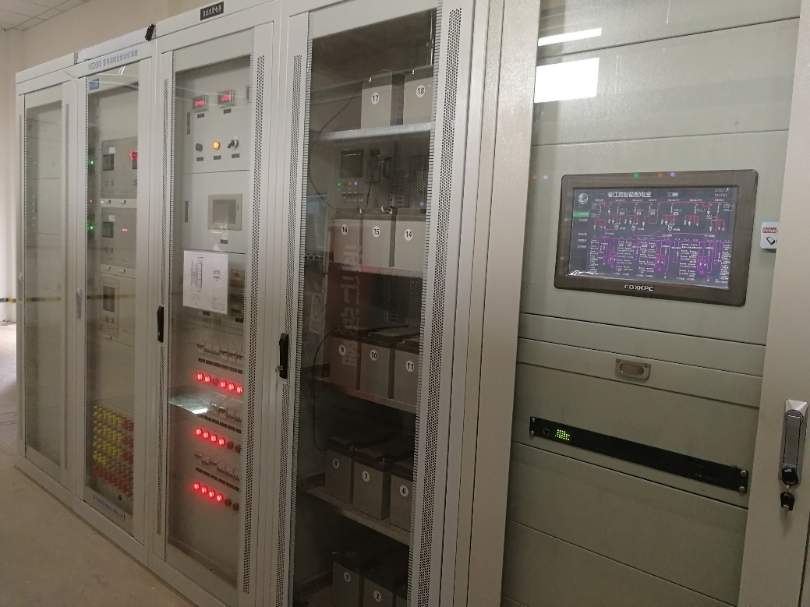
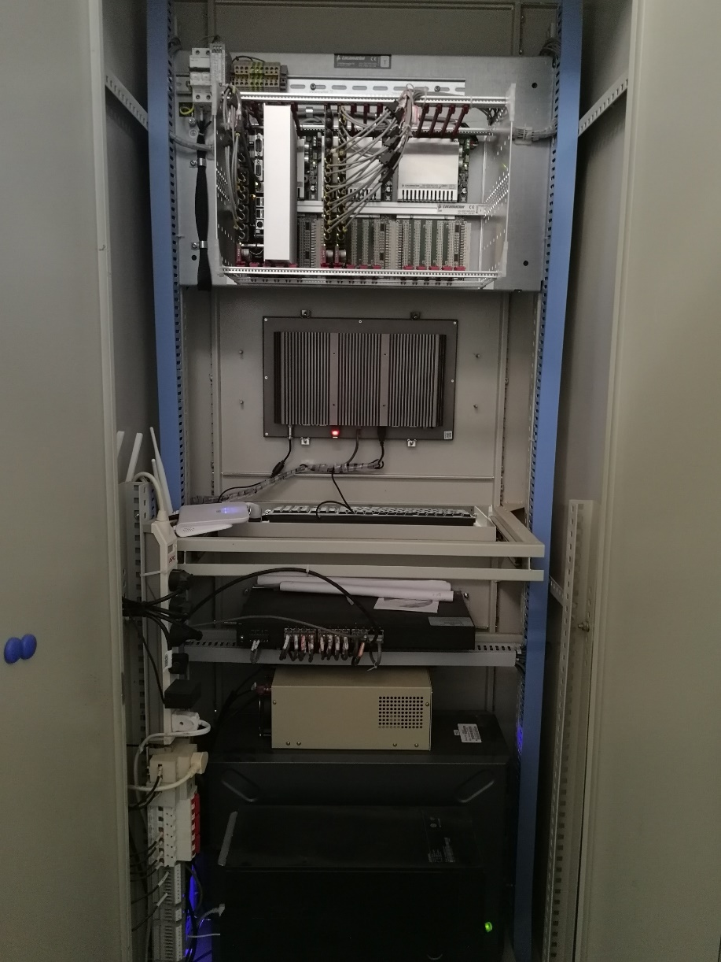
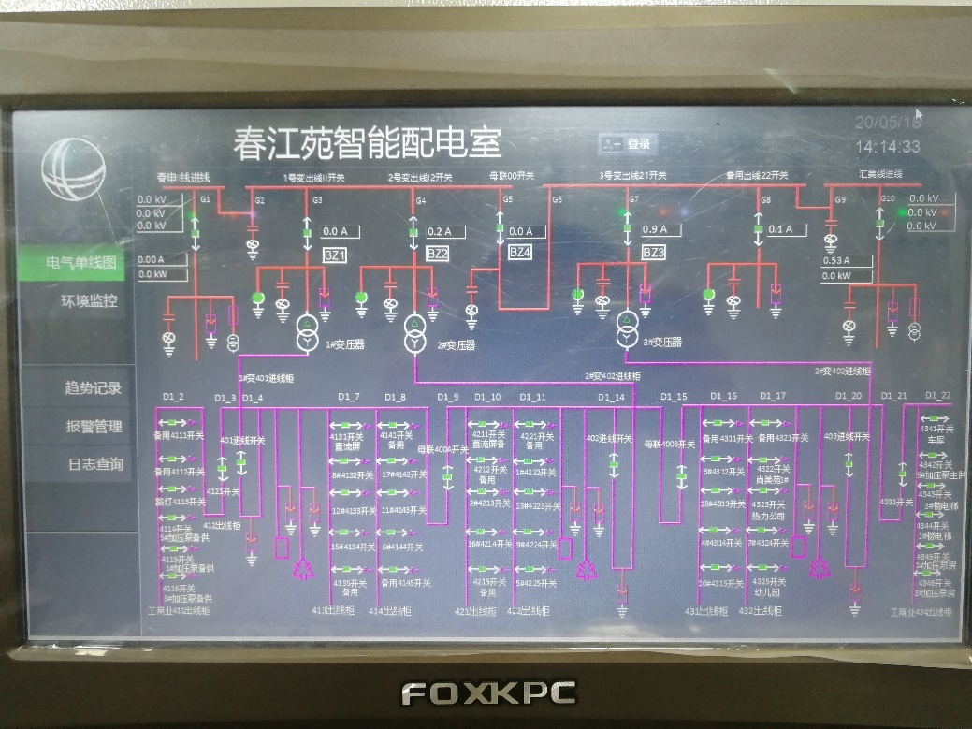
BLE
IPC - PcVue
router
Mobility Server

Slide 16
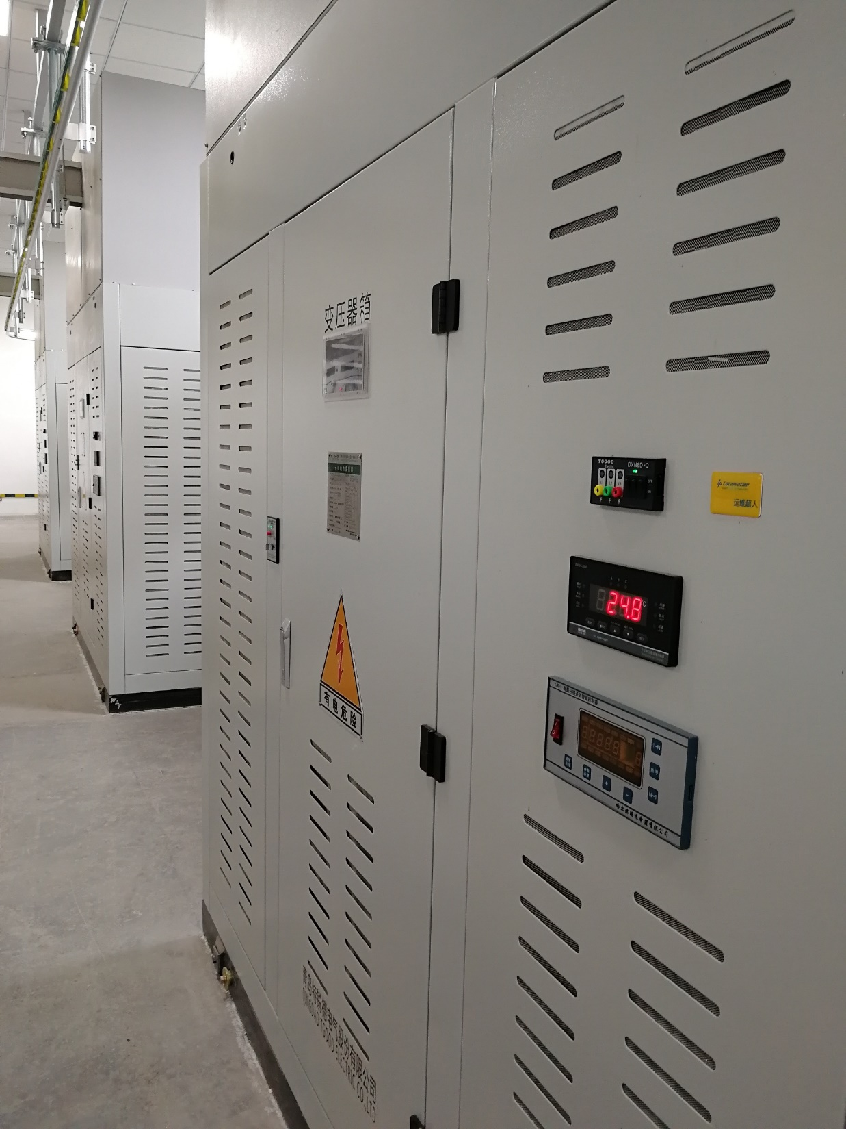
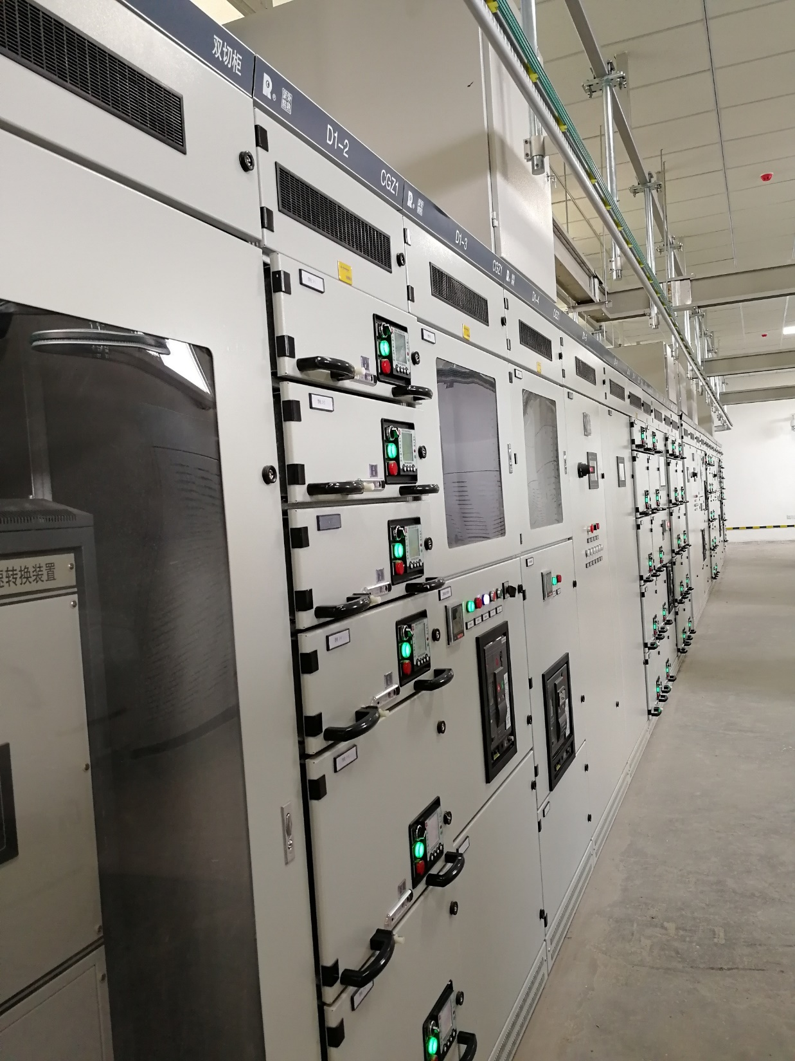
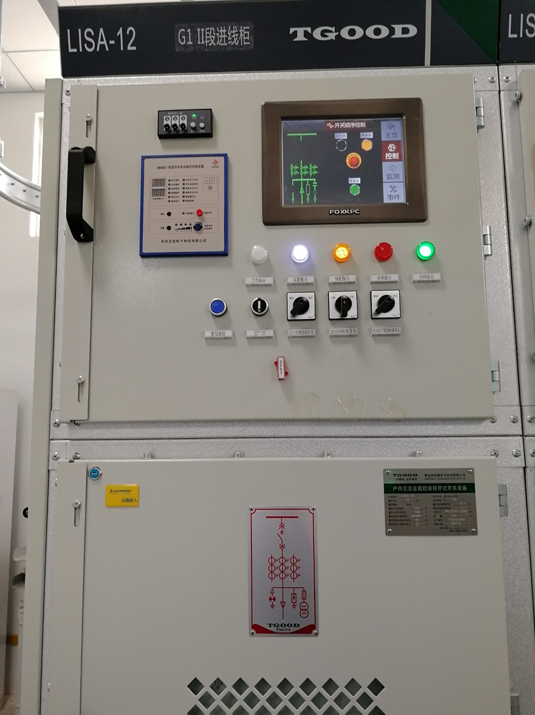

Slide 17
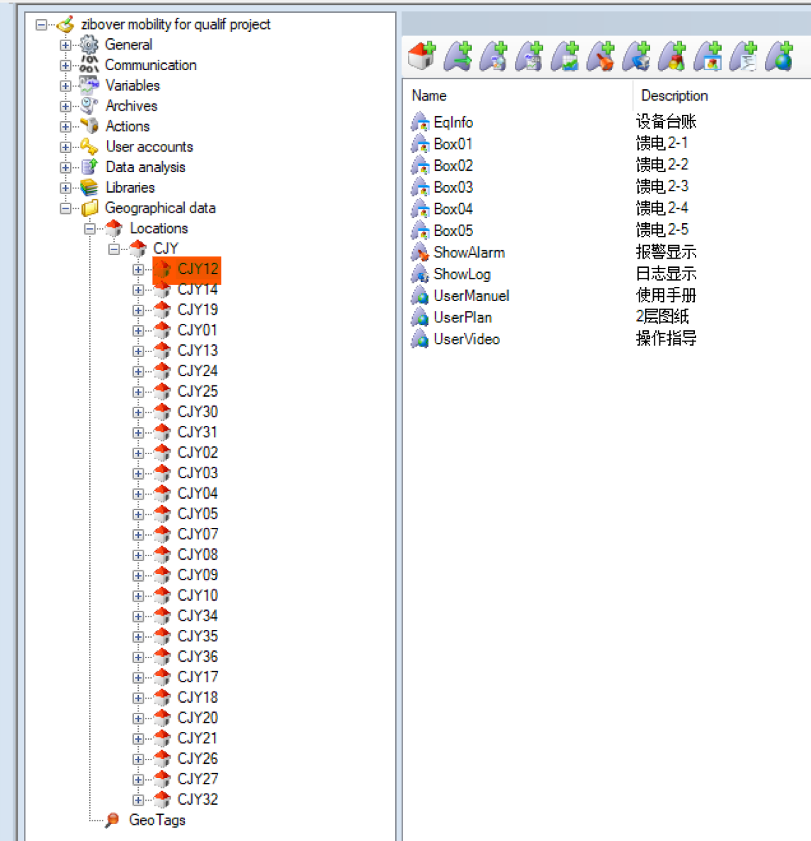
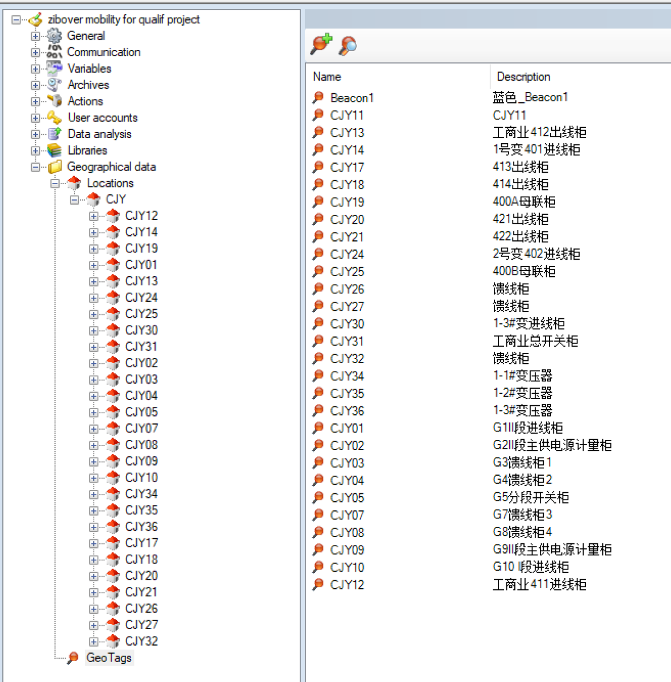
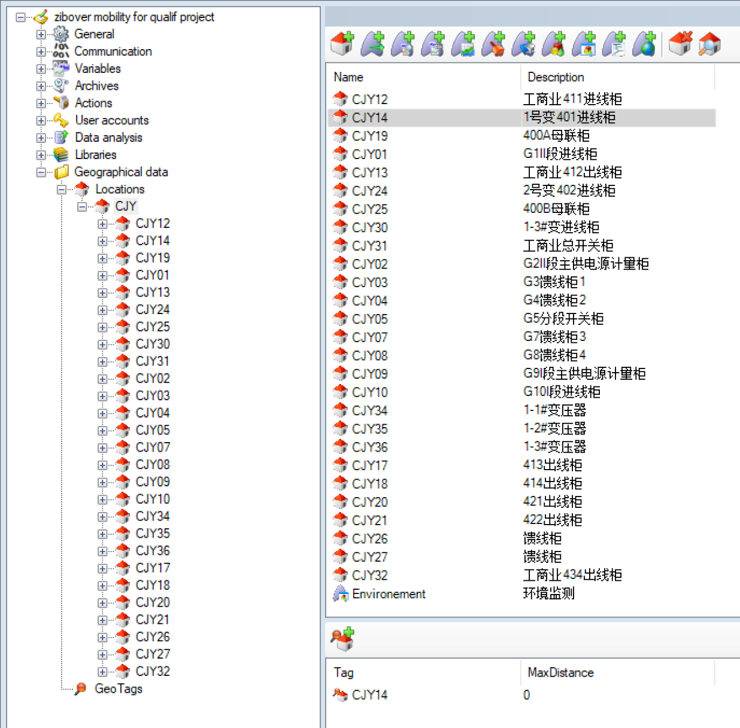
Mobility Configuration

Slide 18
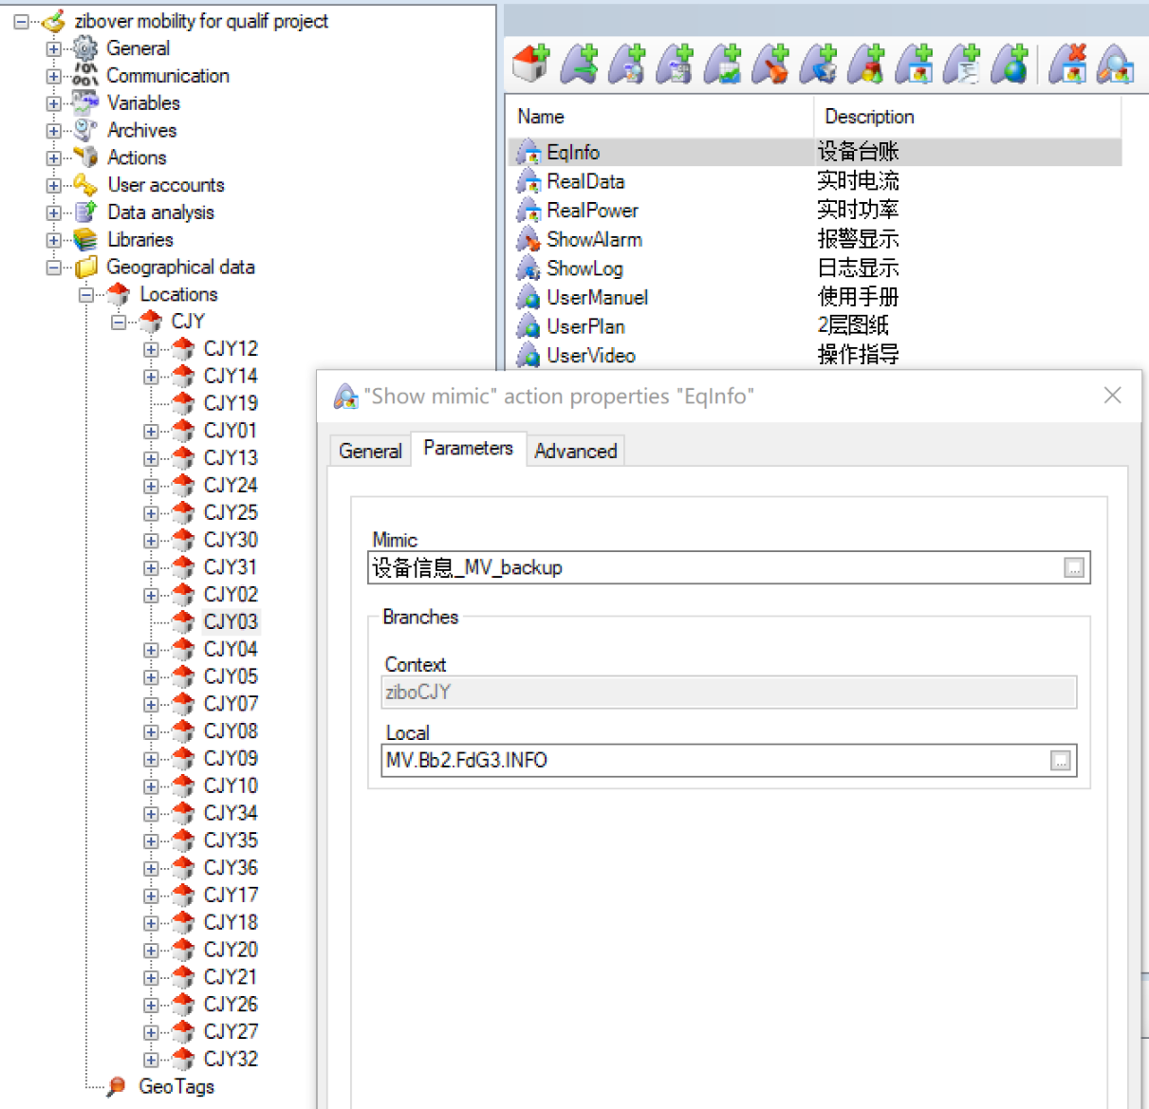
Mobility Configuration

Slide 19
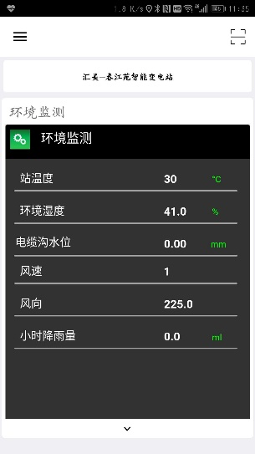
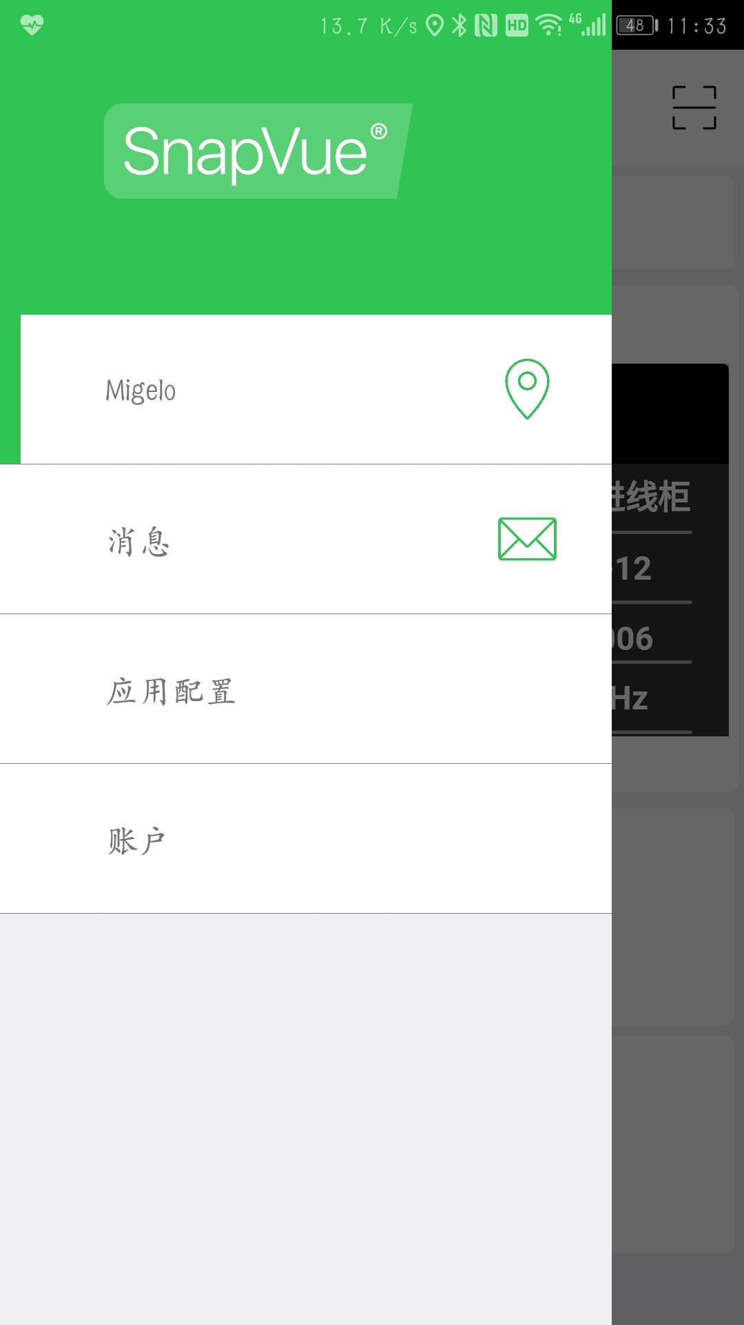
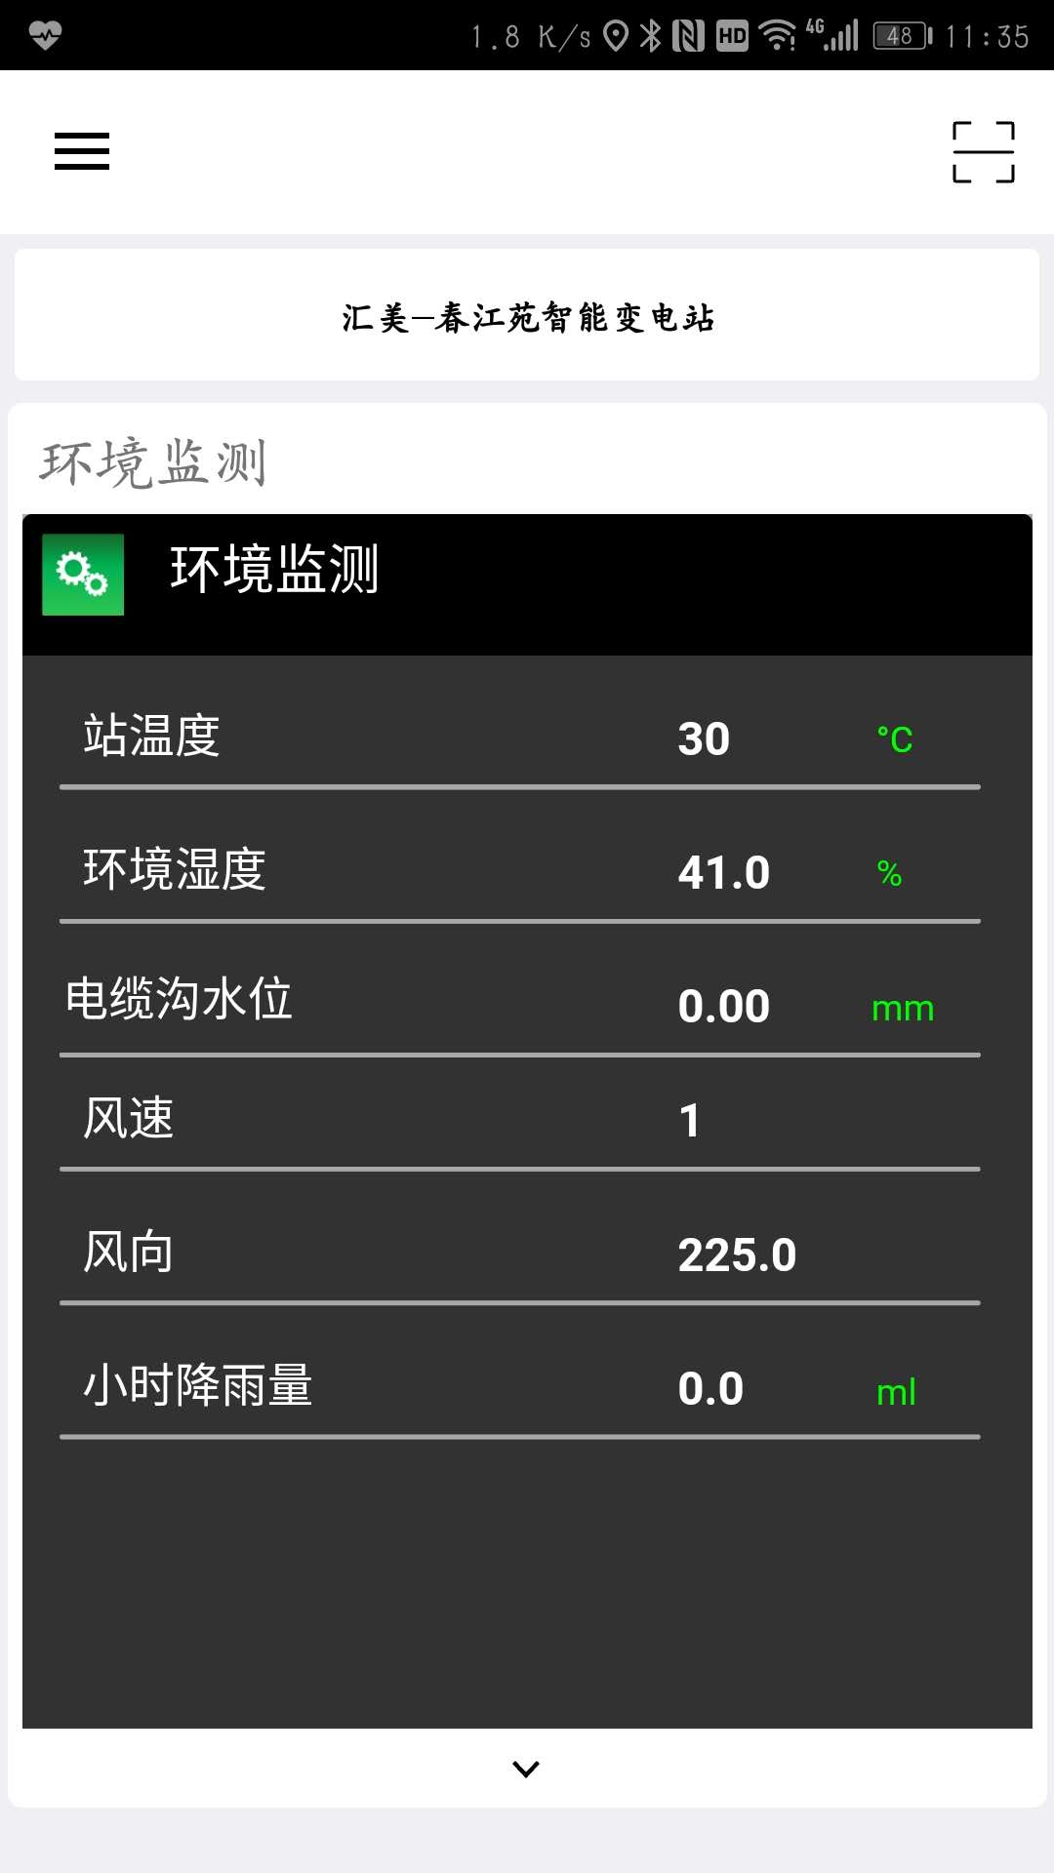
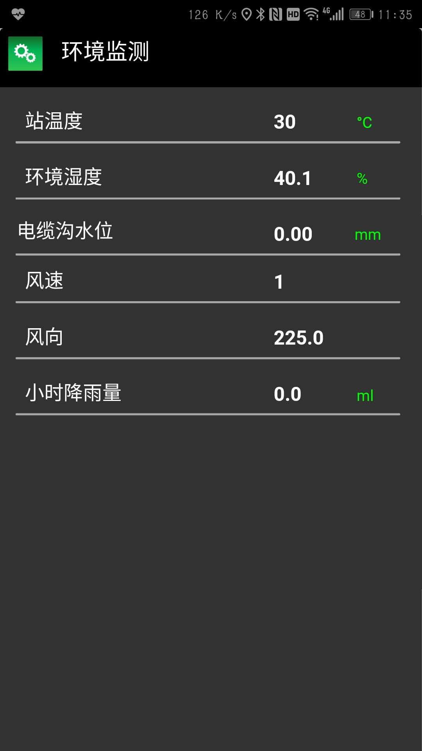
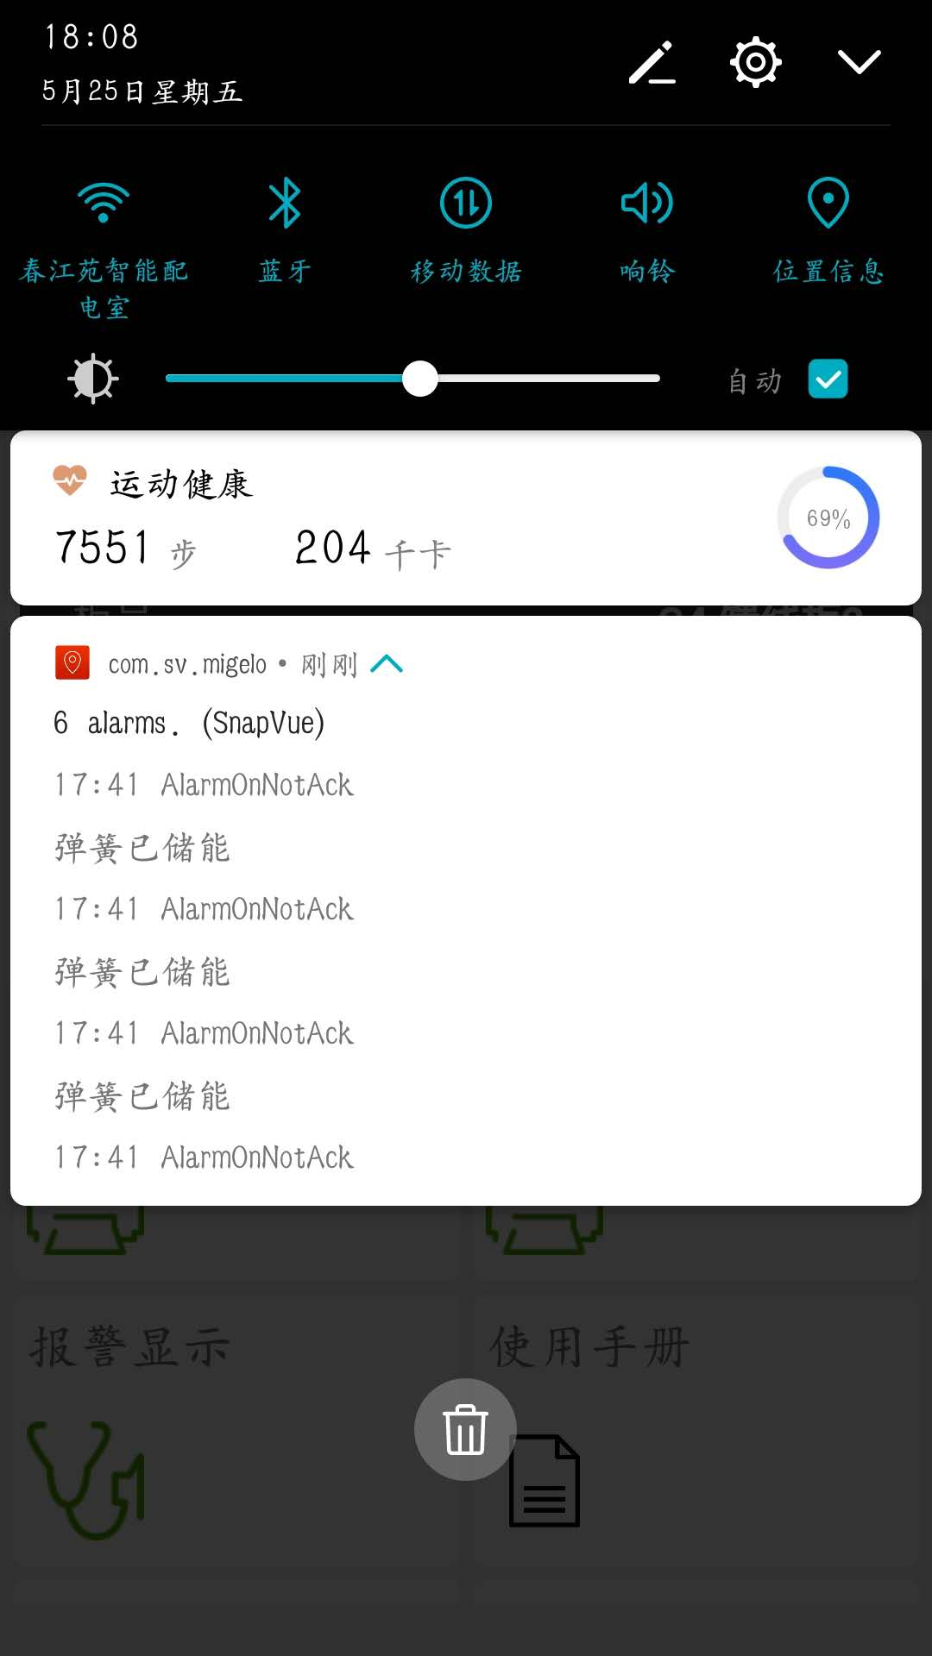
Mobility UI
Main View once entering the Substation

Slide 20
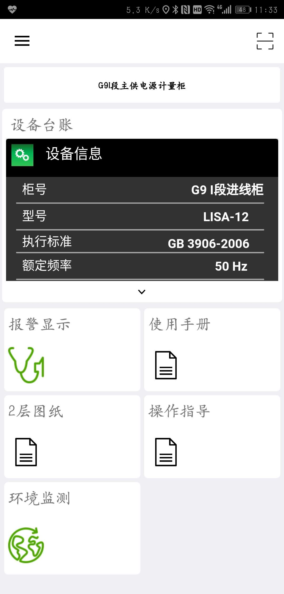
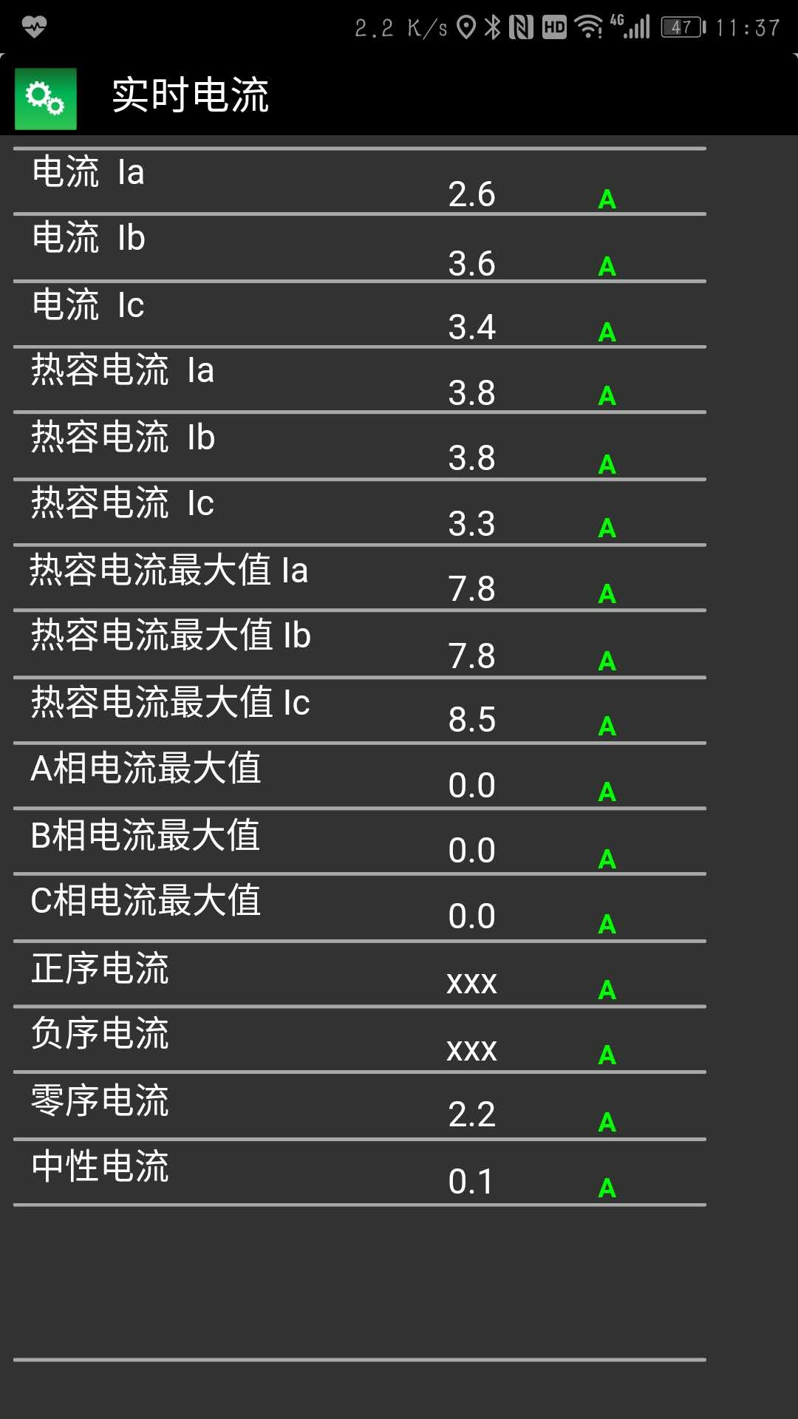
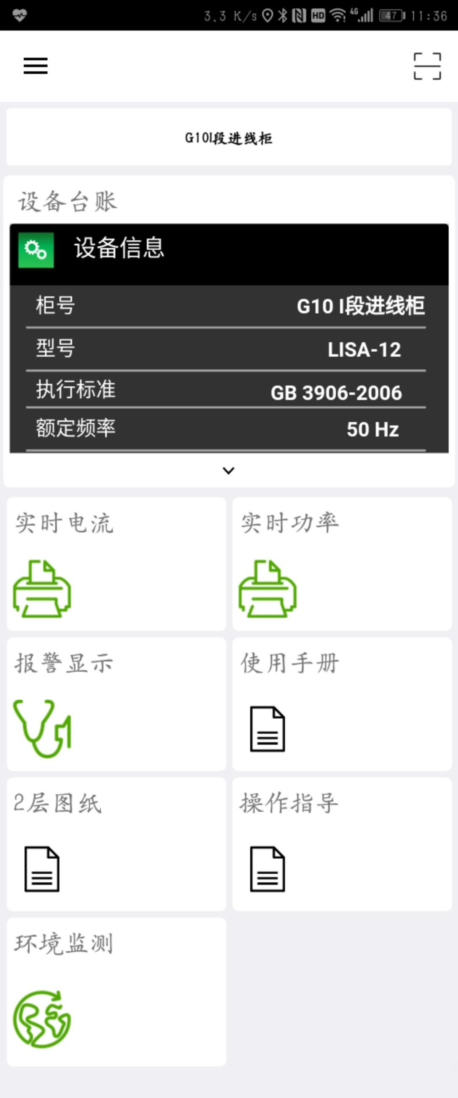
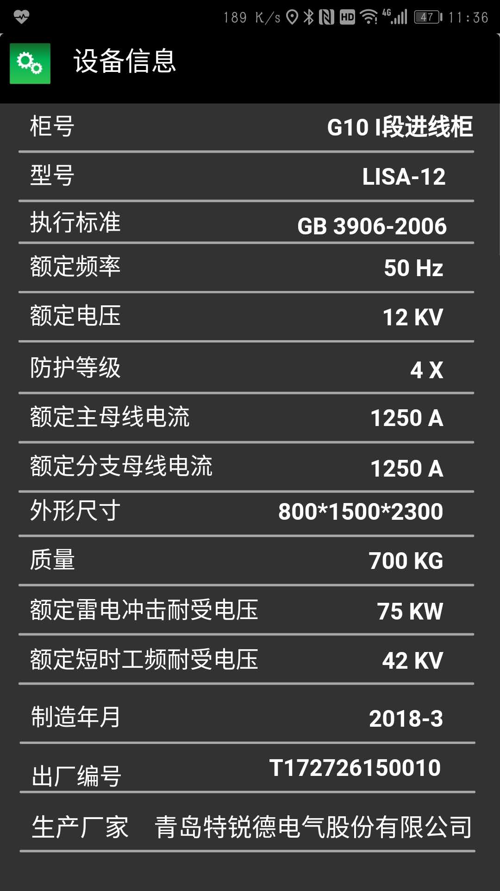
Mobility UI
A MV Incomer view

Slide 21
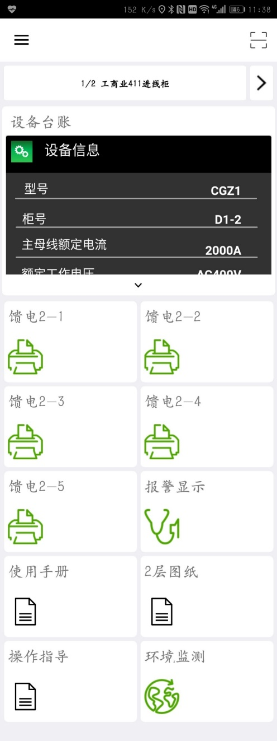
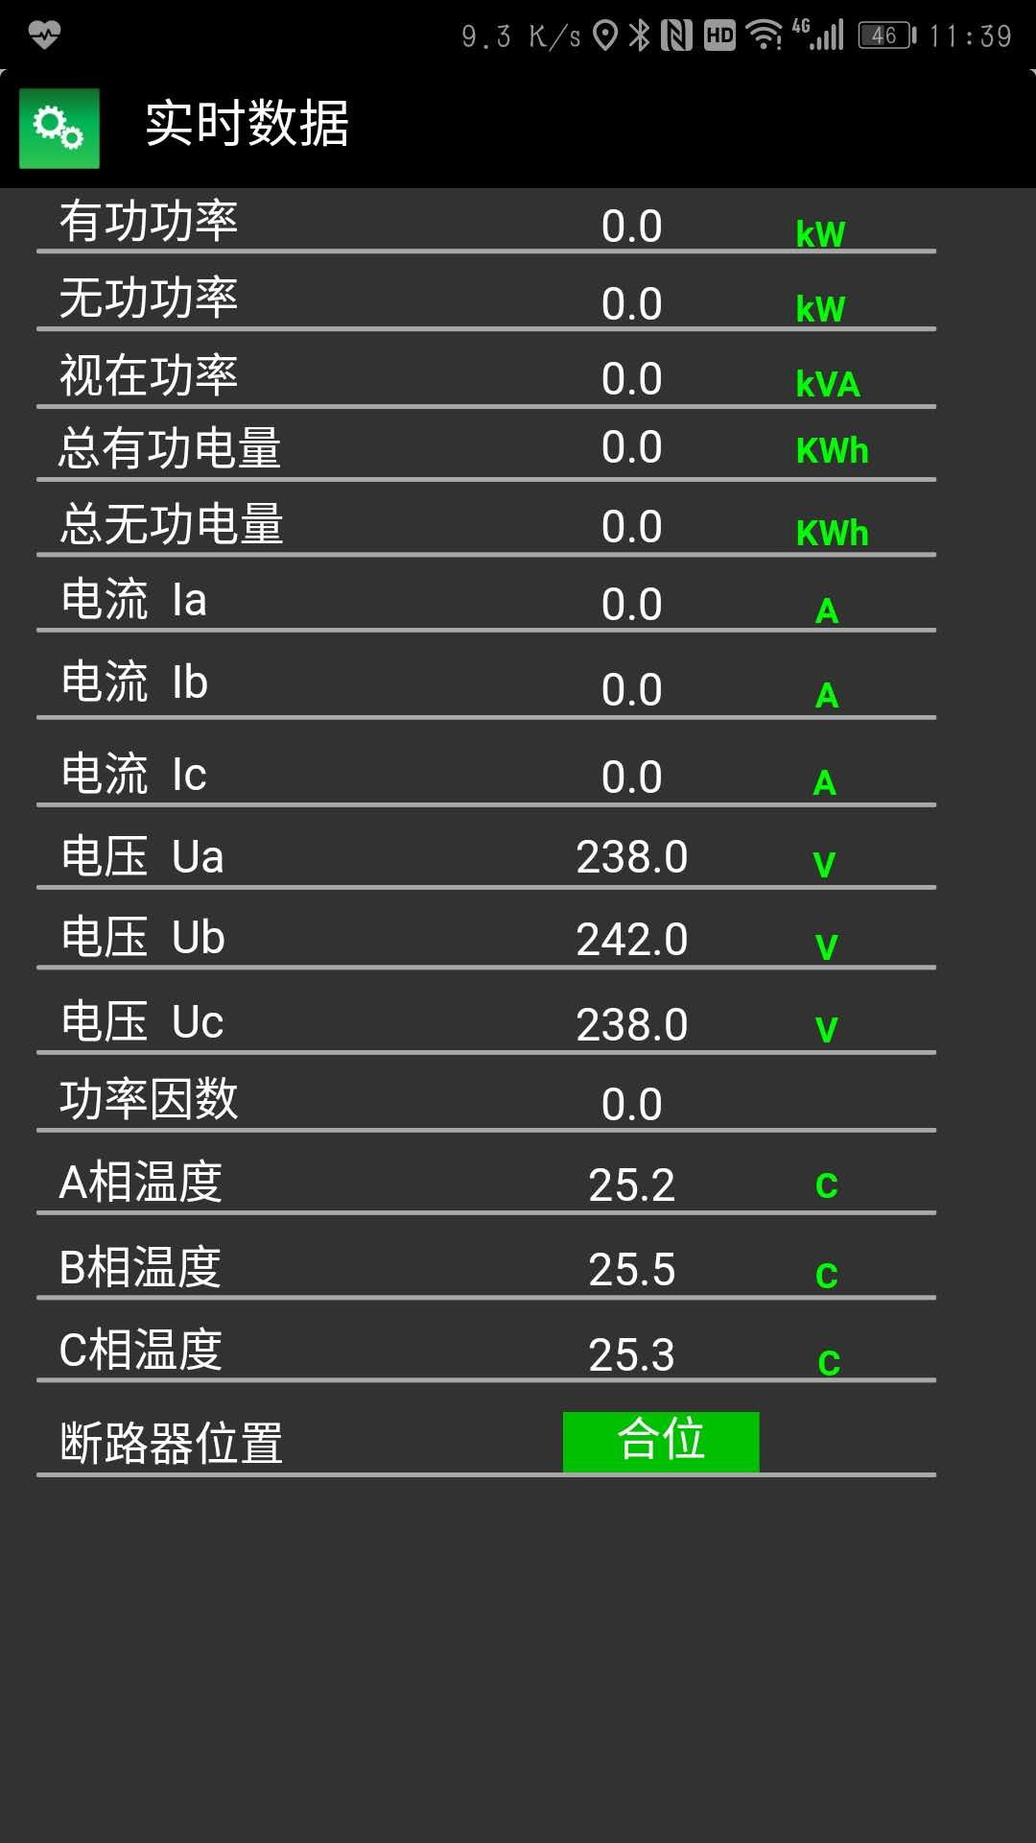
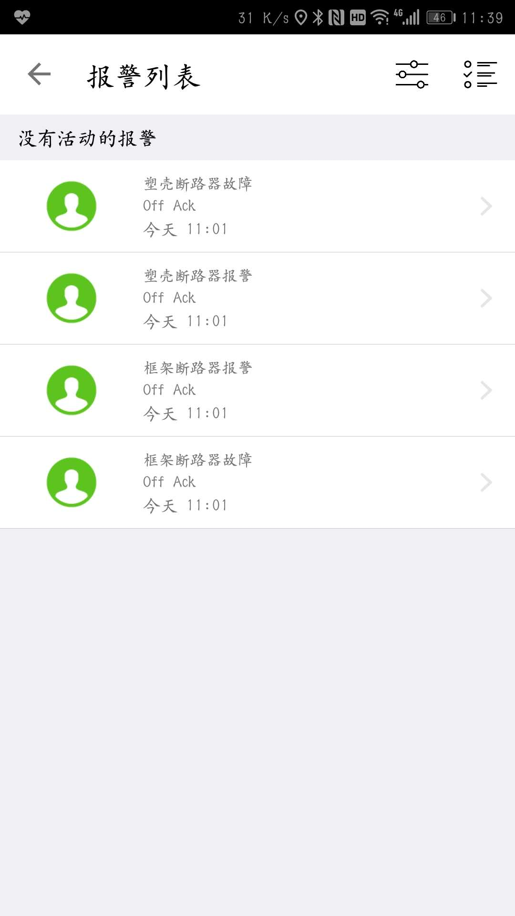
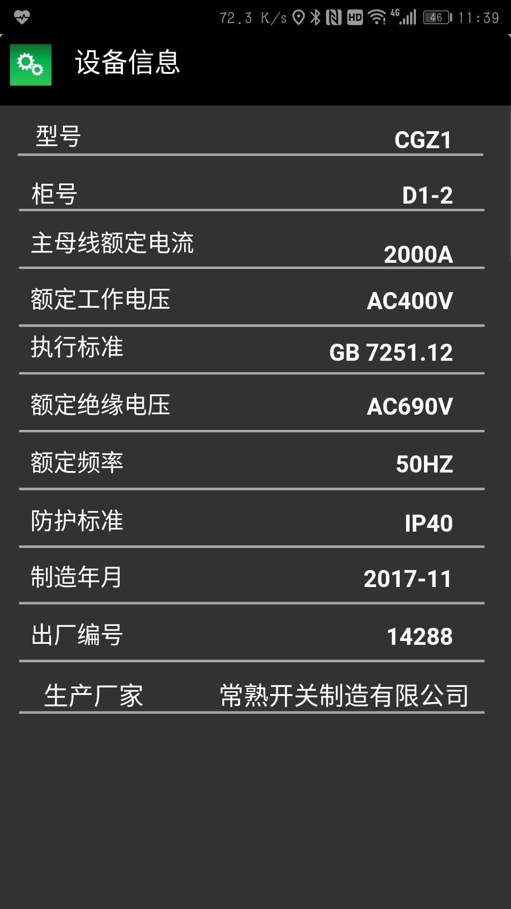
Mobility UI
A LV Feeder view

Slide 22
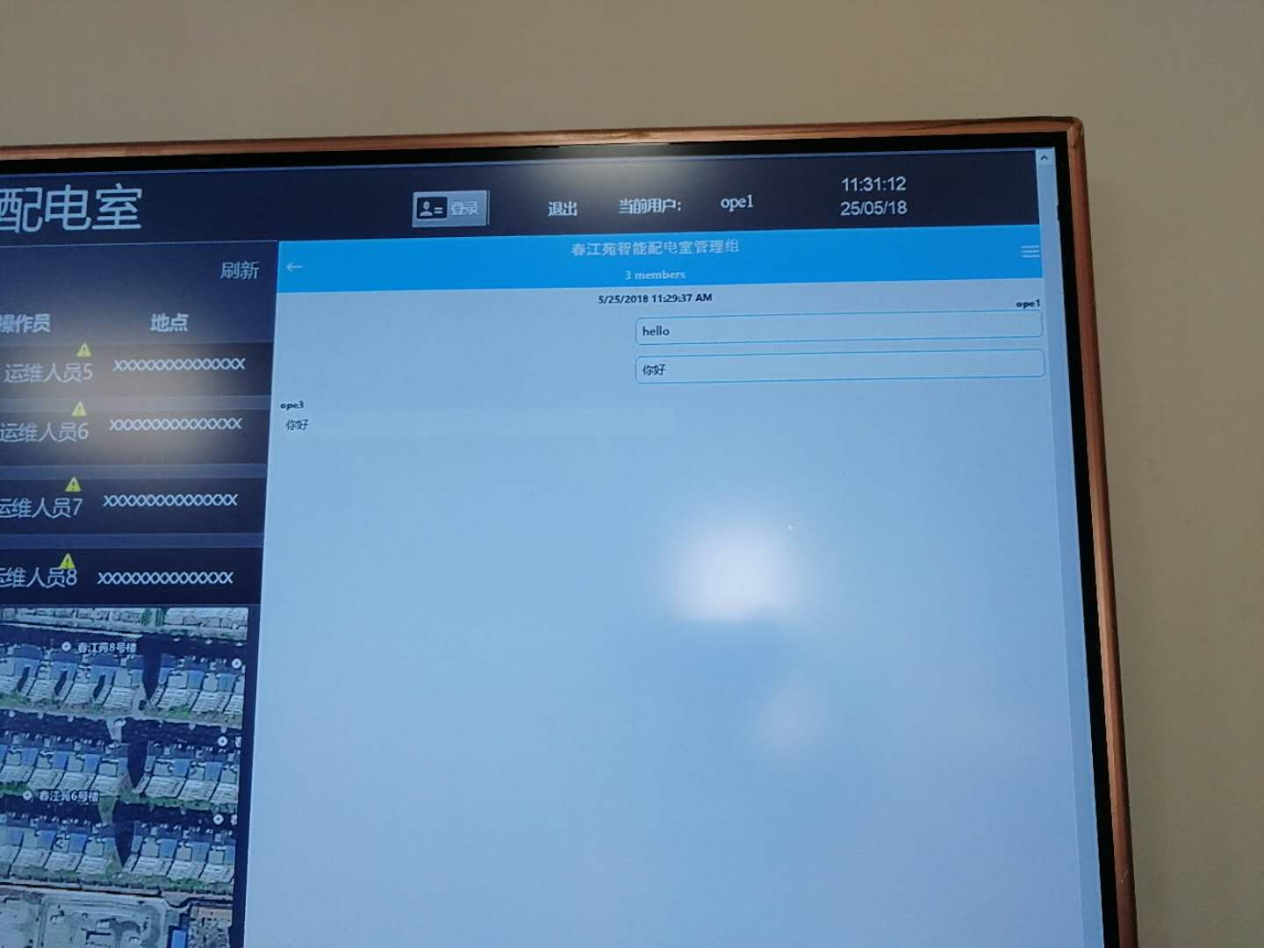
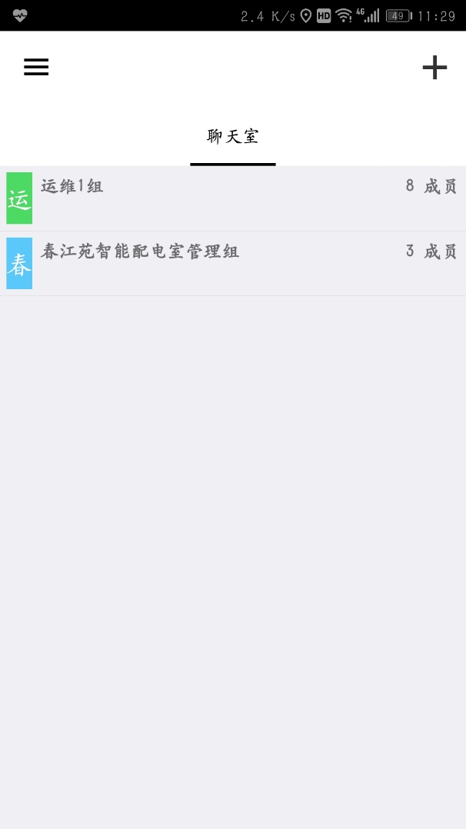

Mobility UI
Messenger view

Slide 23




Web Portal UI
Web Portal

Slide 24
Feedback: the good
Roadmap
It is in phase with the “ digitalization process” of the Chinese industry. Snapvue goes hand in hand with the needs to better manage dispatch team and their work.
Showing documents (pdf and video) on the phone based on the equipment is still one of the most interesting aspects of SnapVue.
The messenger function is the cherry on the cake.
Stable version
Notes:
For Locamation and ChunJiangyuan project, it is still ongoing, but we have this time a full version of SnapVue with all functionalities (trends, alarm, messenger). So far, the feedbacks are:
People don’t care about the certificate. It’s hard to explain and get them to understand why we they need to buy one. We just say that’s the government request and we are only compliant where others are not.
We have an issue with the trends so far, because they are limited to 8 only (but they are working on displaying 16 trends right now). Another issue is the rendering of the trends that are not customizable like in PcVue (can’t chose the color, can’t chose the type of lines, etc.).
The biggest issue is that SnapVue so far is a closed system. For instance, we can’t interface it with
the work order of a CMMS, an ERP, etc. I have raised this request to the dev and was told it is possible to update the API to at least be able to call the webpage of a CMMS regarding a specific device number and job order, and automatically log in but… it’s not planned so far in this version. That is a huge drawback for us as all our customers ask for integration with work order management.
An indoor navigation system. Some customers asked us to provide indoor navigation which many other dedicated software can do. The easiest thing would be to interface with them.
Another issue is that we have not built anything solid to support some analytics on the server side. If you want to display how many times someone went to a site in a month, you have to script a lot. Or if you want to search for all the intervention of user X at this location Y for one specific date, you can’t do it in PcVue (we just have the log viewer).
Although the messenger function s a great hit, there’s a huge issue in that it can’t be displayed on the web. I’ve discussed with Anton and actually, all the messages are saved in sdf format (a compact SQL file format) and we can access all those data by REST. I’m meeting with a company this Friday to discuss if they can build a web messenger using an existing framework, and use our API. Our customer absolutely needs it on their web portal.
The last but not the least, we can’t display some static information without building a dedicated HMI. We can’t display for instance a list of equipment data (reference number, manufacturing date, name of manufacturer) directly in SnapVue interface, we need to display a webvue mimic, which is very bad when the manufacturer already puts his data on his NFC…. ☹

Slide 25
Feedback: tips
Roadmap
People don’t care about the certificate -> we talk about compliance where competitors are not.
No automatic resolution adoption for snapvue-> design well your UI
Use Wifi detection as a zone tag, better than BLE
Notes:
For Locamation and ChunJiangyuan project, it is still ongoing, but we have this time a full version of SnapVue with all functionalities (trends, alarm, messenger). So far, the feedbacks are:
We have an issue with the trends so far, because they are limited to 8 only (but they are working on displaying 16 trends right now). Another issue is the rendering of the trends that are not customizable like in PcVue (can’t chose the color, can’t chose the type of lines, etc.).
The biggest issue is that SnapVue so far is a closed system. For instance, we can’t interface it with
the work order of a CMMS, an ERP, etc. I have raised this request to the dev and was told it is possible to update the API to at least be able to call the webpage of a CMMS regarding a specific device number and job order, and automatically log in but… it’s not planned so far in this version. That is a huge drawback for us as all our customers ask for integration with work order management.
An indoor navigation system. Some customers asked us to provide indoor navigation which many other dedicated software can do. The easiest thing would be to interface with them.
Another issue is that we have not built anything solid to support some analytics on the server side. If you want to display how many times someone went to a site in a month, you have to script a lot. Or if you want to search for all the intervention of user X at this location Y for one specific date, you can’t do it in PcVue (we just have the log viewer).
Although the messenger function s a great hit, there’s a huge issue in that it can’t be displayed on the web. I’ve discussed with Anton and actually, all the messages are saved in sdf format (a compact SQL file format) and we can access all those data by REST. I’m meeting with a company this Friday to discuss if they can build a web messenger using an existing framework, and use our API. Our customer absolutely needs it on their web portal.
The last but not the least, we can’t display some static information without building a dedicated HMI. We can’t display for instance a list of equipment data (reference number, manufacturing date, name of manufacturer) directly in SnapVue interface, we need to display a webvue mimic, which is very bad when the manufacturer already puts his data on his NFC…. ☹

Slide 26

Feedback: room for improvement
Roadmap
Issue with trends limitation on snapvue (being modified as we speak)
Can’t display some static information without building a dedicated HMI. For instance, we can’t display a list of equipment data (reference number, manufacturing date, name of manufacturer) already written in the NFC tag and display directly in SnapVue interface
No responsive design (automatic resolution adoption) for snapvue
Limitation of WebVue API. Can only use iFrame to display mimic in web portal.
Notes:
For Locamation and ChunJiangyuan project, it is still ongoing, but we have this time a full version of SnapVue with all functionalities (trends, alarm, messenger). So far, the feedbacks are:
We have an issue with the trends so far, because they are limited to 8 only (but they are working on displaying 16 trends right now). Another issue is the rendering of the trends that are not customizable like in PcVue (can’t chose the color, can’t chose the type of lines, etc.).
The biggest issue is that SnapVue so far is a closed system. For instance, we can’t interface it with
the work order of a CMMS, an ERP, etc. I have raised this request to the dev and was told it is possible to update the API to at least be able to call the webpage of a CMMS regarding a specific device number and job order, and automatically log in but… it’s not planned so far in this version. That is a huge drawback for us as all our customers ask for integration with work order management.
An indoor navigation system. Some customers asked us to provide indoor navigation which many other dedicated software can do. The easiest thing would be to interface with them.
Another issue is that we have not built anything solid to support some analytics on the server side. If you want to display how many times someone went to a site in a month, you have to script a lot. Or if you want to search for all the intervention of user X at this location Y for one specific date, you can’t do it in PcVue (we just have the log viewer).
Although the messenger function s a great hit, there’s a huge issue in that it can’t be displayed on the web. I’ve discussed with Anton and actually, all the messages are saved in sdf format (a compact SQL file format) and we can access all those data by REST. I’m meeting with a company this Friday to discuss if they can build a web messenger using an existing framework, and use our API. Our customer absolutely needs it on their web portal.
The last but not the least, we can’t display some static information without building a dedicated HMI. We can’t display for instance a list of equipment data (reference number, manufacturing date, name of manufacturer) directly in SnapVue interface, we need to display a webvue mimic, which is very bad when the manufacturer already puts his data on his NFC…. ☹

Slide 27

Feedback: quest for improvement
Roadmap
No back end data for analytics on the server side (monthly usage per user per zone, search tool in historical data) which takes out half of the potential of mobility offer.
Closed system : interface with Work order system, indoor navigation system
Web client for messenger. In talk with IT company as we speak.
Example of work order made in pcvue/webvue
Notes:
For Locamation and ChunJiangyuan project, it is still ongoing, but we have this time a full version of SnapVue with all functionalities (trends, alarm, messenger). So far, the feedbacks are:
We have an issue with the trends so far, because they are limited to 8 only (but they are working on displaying 16 trends right now). Another issue is the rendering of the trends that are not customizable like in PcVue (can’t chose the color, can’t chose the type of lines, etc.).
The biggest issue is that SnapVue so far is a closed system. For instance, we can’t interface it with
the work order of a CMMS, an ERP, etc. I have raised this request to the dev and was told it is possible to update the API to at least be able to call the webpage of a CMMS regarding a specific device number and job order, and automatically log in but… it’s not planned so far in this version. That is a huge drawback for us as all our customers ask for integration with work order management.
An indoor navigation system. Some customers asked us to provide indoor navigation which many other dedicated software can do. The easiest thing would be to interface with them.
Another issue is that we have not built anything solid to support some analytics on the server side. If you want to display how many times someone went to a site in a month, you have to script a lot. Or if you want to search for all the intervention of user X at this location Y for one specific date, you can’t do it in PcVue (we just have the log viewer).
Although the messenger function s a great hit, there’s a huge issue in that it can’t be displayed on the web. I’ve discussed with Anton and actually, all the messages are saved in sdf format (a compact SQL file format) and we can access all those data by REST. I’m meeting with a company this Friday to discuss if they can build a web messenger using an existing framework, and use our API. Our customer absolutely needs it on their web portal.
The last but not the least, we can’t display some static information without building a dedicated HMI. We can’t display for instance a list of equipment data (reference number, manufacturing date, name of manufacturer) directly in SnapVue interface, we need to display a webvue mimic, which is very bad when the manufacturer already puts his data on his NFC…. ☹

Slide 28


Roadmap with Locamation
DB Connect for Hbase: TBD. Temporary solution with HDS+SQOOP or HDS+Data Export but complicated => historian solution vs traditional big data
Connection to third part webpage from SnapVue: TBD
Improve AA
Connection to intelligent robot

Slide 29
Next step
Same application for QINGDAO CITY in much bigger scale (100 substations) in 2018-19 if POC successful.
Same application for Wurumuqi CITY in much bigger scale (50 substations) in 2018-19 if POC successful.
Business model by license vs by asset, by access vs by devices

